Slide 1
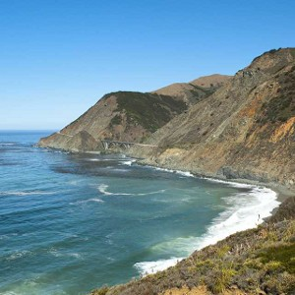
Central Coast Chapter Meeting
November 21, 2024
Notes:
Image from CA Chapters website

Slide 2
Agenda
Chapter Business 12:05
Chapter Updates and 2025 Officer Nominations
Chapter Trustee Report
Legislative, Regulatory, and Funding Updates
Next Central Coast Chapter Meeting
Date: January 2025
WateReuse California Update 12:15
Agency Roundtable/Monthly Newsletter Updates 12:25
Presentation 12:30
Tour (In-Person Only) 12:50
Adjourn Meeting 1:30

Slide 3
Chapter Updates Shannon Jessica

Slide 4
WRCA Central Coast Chapter Updates
2025 WateReuse Central Coast Chapter Officer Nominations
President
Must have served role on Board Previously
Vice President (North, Central, South)
Must live within region
Secretary/Treasurer
Legislative and Regulatory Representative
Membership and Outreach Representative
Chapter Trustee
Must have served role on Board Previously
Members-at-Large
*All positions must live within the Chapter

Slide 5
Chapter Trustee Report Gina Dorrington on behalf of Rob Morrow

Slide 6
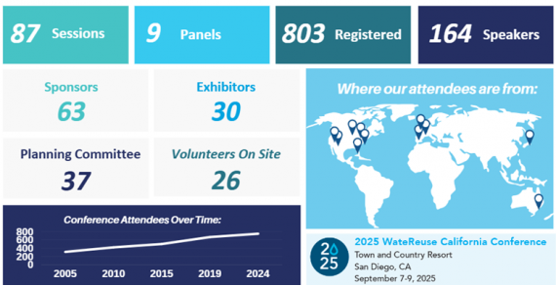
Chapter Trustee Report
Board of Trustees Meeting at CA Annual Conference September 15, 2024
Conference:
Numbers topped near 800 in attendance

Slide 7
Chapter Trustee Report Board of Trustees Meeting - September 19, 2024
Membership
Goal had been set at bringing in $67,556 for new memberships – actual = $6,898
95% of Revenue comes from membership
California held membership fee increases to allow National WateReuse increases, but will now explore a modest increase to support additional staffing and outreach
Check for your renewal invoices!
National has expanded to Midwest, including Ohio and Idaho
Launch of Strategic Planning
Board heard from Strategic Planner Consultant and interviews were conducted during conference.
Please take the time to participate in surveys when they hit your inbox

Slide 8
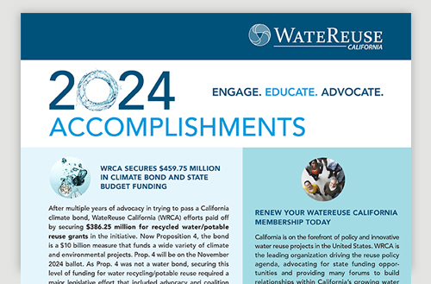
Chapter Trustee Report Board of Trustees Meeting - September 19, 2024
Request for Emeritus Role for former Board members
Check in on WateReuse.org/Sections/watereuse-California
How can we help encourage membership at a Chapter level?
Reach out to regional neighbors and partners
Share meeting calendar, invite others to our meetings
Volunteer for Leadership – such as Trustee!

Slide 9
Legislative, Regulatory, and Funding Updates Alec Roberts aroberts@cityofventura.ca.gov

Slide 10
Leg/Reg/Funding Update: State Bills
Climate Bond (Prop 4) PASSED!
$10 Billion for environmental and energy initiatives
$3.8B - Drought, Flood and Water Supply Projects
$1.2B - Restore and Protect Coastal Areas exposed to Sea Level Rise
$1.2B – Conservation and Habitat Restoration
40% of the total funds must be spent on activities that benefit lower-income communities and areas more exposed to climate change.
Notes:
Prop. 4 authorizes the state to sell the bond to fund grants and loans to local governments, Native American tribes, non-profit organizations and businesses.
The lion's share of the money — $3.8 billion — is reserved for drought, flood and water supply projects, including dam repair.
Prop. 4 also includes $1.5 billion for forest health and wildfire prevention, $1.2 billion to restore and protect coastal areas exposed to sea-level rise, $1.2 billion for conservation and habitat restoration, and $850 million for energy projects.
Of the energy funds, $475 million will go toward offshore wind development and $325 million is pegged to grid infrastructure like long-distance transmission. The remaining $50 million is tied to energy storage.
Another $700 million will go to parks, while $450 million is slated to protect communities from extreme heat and $300 million is for farms and agriculture.
At least 40% of the total funds must be spent on activities that benefit lower-income communities and areas more exposed to climate change.

Slide 11
2025 WRCA Legislative Goals
Title 22 Updates
Allow for disinfected tertiary water to be used in parks near outdoor eating areas
Allow for disinfected tertiary water to used for all dual plumbed facilities except in the immediate area where food is prepared
The outdoor landscape area on properties where the HOA owns and maintains landscaping shall not be treated as if it were dual plumbed.
Allow RW stored in impoundments (i.e. pond, decorative lake) mixed with stormwater to overflow without being a rw discharge, so impoundment levels are lowered significantly in winter.
Water Code 13529.2
Clarify definition of RW to specify the product is considered recycled water once the treatment process is complete.
Currently: An “unauthorized discharge” of RW is being interpreted as severe as a spill as raw sewage until the recycled water reaches its “end use” as deﬁned in a regional board permit.
Notes:
SRF
State board wants to update the policy documents that go with SRF (Not IUP, which is updated annually)
Scoring criteria, and non funding changes
I suggested
MADS requirements should be revisited (Shivaji Deshmukh at IEUA agreed, Sharon Green at LACSD wants broad changes)
Points for people with legal obligations
Reach out to Beth Olhasso to get more involved on developing these recommendations for
Officially add IPR and DPR to drinking water SRF?
We will likely push this but it will anger Environmental Groups and impacts Disadvantage Communities
SWRCB -Right to assess fees for recycled water permits
See prior meeting notes
Internally discussing options
For all permits that have RW components
WDR, NPEDES, etc.
Options role out in May, Workshop in June, implement in Fall
Additional fees for recycled water
WRR's that are not paying any fees at all
One permit for NPEDES and WRRs
Fee would increase for the WRR portion of the permit (surcharge)
Could have fees for agencies without WRRs (potentially)
stakeholder meetings between now and June's broader water quality stakeholder meeting
This is in addition to potable reuse costs for DDW
This is for regional costs

Slide 12
Anticipated 2025 Regulatory Topics
SB 1157 (Statutes 2022, Chapter 679, Hertzberg), DWR Overall Committee and Think Tank Process
Division of Drinking Water Recycled Water Unit Positions
Regulations for Onsite Treatment
Volumetric Annual Report (VAR) of Wastewater and Recycled Water

Slide 13
Agency Roundtable/California WateReuse Monthly Newsletter Input Steve Thomas

Slide 14
WateReuse California Updates Brenley McKenna

Slide 15
Today’s Presentation
City of Watsonville and Pajaro Valley Water Management Agency’s Agriculture Irrigation Reuse Program
Shinehah Bingham, PV Water
Marcus Mendiola, PV Water

