Slide 1
Central Coast Chapter Meeting
July 25, 2024
Notes:
Image from CA Chapters website

Slide 2
Agenda
Chapter Business 12:00
Chapter Updates
Legislative, Regulatory, and Funding Updates
Next Central Coast Chapter Meeting
Mixer at WateReuse California Annual Conference
Date: Sunday, September 15, 2024
Time: 7PM
Agency Roundtable/Monthly Newsletter Updates 12:15
Presentation:
Prepping Your Wastewater for Future Potable Reuse 12:20
Adjourn Meeting 1:00

Slide 3
Chapter Updates Shannon Jessica

Slide 4
WRCA Central Coast Chapter Updates
2024 WateReuse California Conference
September 15 – 17 2024 in Garden Grove, CA
Central Coast Chapter Mixer
Mixer at WateReuse California Annual Conference
Date: Sunday, September 15, 2024
Time: 7PM
Location: Oggi’s Pizza and Brewing Co.
Upcomming events
Industrial Reuse Conference, November 19 -20, Indian Wells, CA
2025 WateReuse Symposium, March 16-19 2025, Tampa, FL

Slide 5
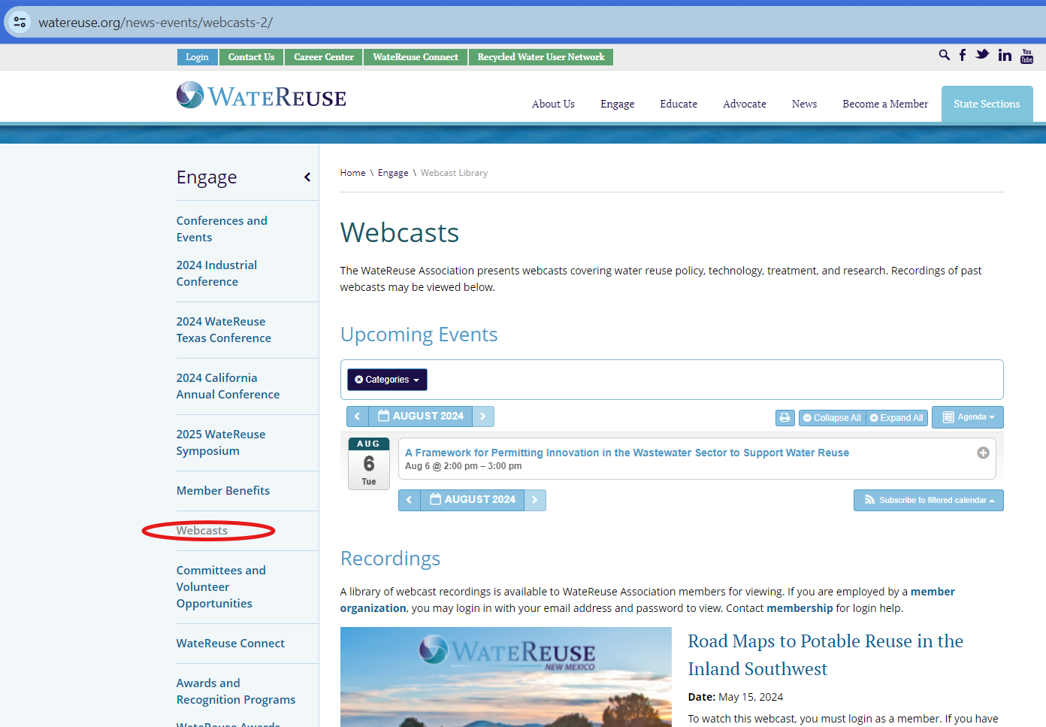
WRCA Central Coast Chapter Updates Webcasts

Slide 6
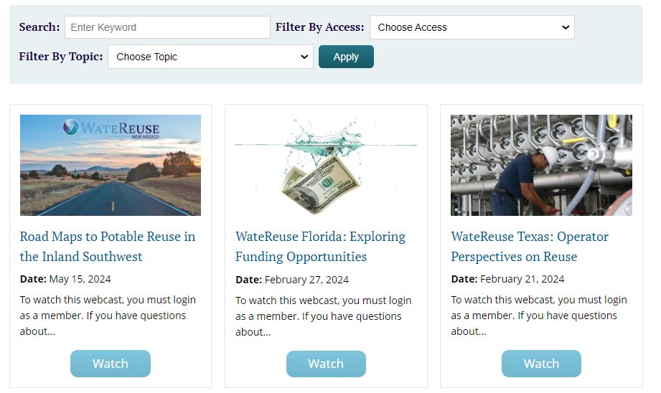
WRCA Central Coast Chapter Updates Webcasts

Slide 7
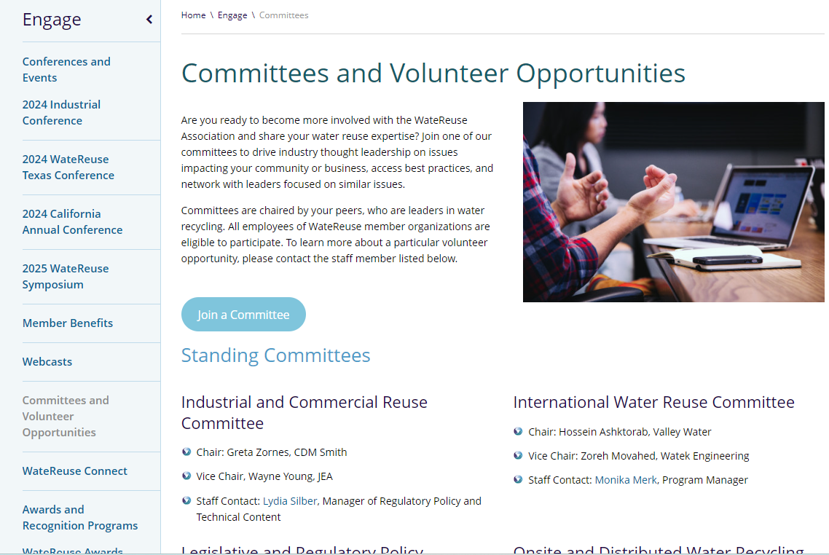
WRCA Central Coast Chapter Updates Committees and Volunteer Opportunities

Slide 8
Legislative, Regulatory, and Funding Updates Alec Roberts aroberts@cityofventura.ca.gov

Slide 9
Leg/Reg/Funding Updates: State Bills
Bill | Topic | Status/Comments
SB 867 AB 1567 - Prop 4 | Climate Bond ($10B) | Approved on July 3rd, voting in Nov. $3.8B for Water $386.25 for RW
SB 1255 | Low Income Rate Assistance | There’s a push for drinking water only
SB 903 | Environmental health: product safety - PFAS | Placed on Suspense file for Hearing
SB 1157 | Urban Water Use Objectives | Passed in 2022 Proposal for $7M for DWR to study impacts of new indoor residential use standards
Notes:
SB 903 - Temper expectations on Bill
Climate Bonds
On July 3, the Legislature approved the $10 billion Safe Drinking Water, Wildfire Prevention, Drought Preparedness, and Clean Air Bond Act of 2024. Acting Governor Senate Pro Tem Mike McGuire quickly signed the measure in place of the Governor.
The Climate Bond includes about $3.8 billion for water, specifically $386.25 million for recycled water. The recycled water allocation is one of the largest pots of funding in the water section of the bond. Significantly, when the bond was reduced from its original $15B amount to $10B, the water recycling pot of funding actually increased!
Should the voters approve the bond in November, appropriations will be made in the budget process. It is likely the Legislature would appropriate recycled water funding over several years.
The final 2024-25 State Budget was also passed recently, on June 28, containing $74.5 million for water recycling. This funding will immediately go to the State Water Resources Control Board for award. At a time when the State Budget had to account for a $30-60B deficit, receiving any General Fund money is a significant accomplishment.
The combined bond and budget funding totals just short of $460 million.

Slide 10
Leg/Reg/Funding Updates
SWRCB Budget
$74.5M approved for Water Recycling Funding Program (WRFP) for FY 24/25
State Revolving Fund Updates
Board wants to update policy documents this year
Scoring criteria to be reviewed
Provide comments now, process to begin at end of summer
SWRCB- Recycled Water Permit Fees
Additional fees for staff time on permits with RW components
WRCA submitted comments and recent workshops were held in June & July
SWRCB- Making Conservation a CA Way of Life
Adopted regulation on water use objectives and long-term efficiency standards for urban water retailers
Notes:
SRF
State board wants to update the policy documents that go with SRF (Not IUP, which is updated annually)
Scoring criteria, and non funding changes
I suggested
MADS requirements should be revisited (Shivaji Deshmukh at IEUA agreed, Sharon Green at LACSD wants broad changes)
Points for people with legal obligations
Reach out to Beth Olhasso to get more involved on developing these recommendations for
Officially add IPR and DPR to drinking water SRF?
WRCA will likely push this but it may upset Environmental Groups and impact Disadvantage Communities
SWRCB -Right to assess fees for recycled water permits
See prior meeting notes
Internally discussing options
For all permits that have RW components
WDR, NPEDES, etc.
Options role out in May, Workshop in June, implement in Fall
Additional fees for recycled water
WRR's that are not paying any fees at all
One permit for NPEDES and WRRs
Fee would increase for the WRR portion of the permit (surcharge)
Could have fees for agencies without WRRs (potentially)
stakeholder meetings between now and June's broader water quality stakeholder meeting
This is in addition to potable reuse costs for DDW
This is for regional costs

Slide 11
Agency Roundtable/California WateReuse Monthly Newsletter Input Steve Thomas

Slide 12
Agency Roundtable/California WateReuse Monthly Newsletter Input Steve Thomas 2024 Conference – September 15-17, Garden Grove, CA WateReuse CA – Central Coast Mixer – Calls for Sponsors

Slide 13
Today’s Presentation
Prepping Your Wastewater for Future Potable Reuse
Kennedy Jenks, Trussel, and Ventura Water

