Slide 1
Central Coast Chapter Meeting
March 21, 2024
Notes:
Image from CA Chapters website

Slide 2
Agenda
Chapter Business 12:00
Chapter Updates
Chapter Trustee Report
Legislative, Regulatory, and Funding Updates
Next Central Coast Chapter Meeting
Date: May XX, 2024
Topic: TBD
Location: TBD
Agency Roundtable/Monthly Newsletter Updates 12:20
Presentation 12:30
Adjourn Meeting 1:00

Slide 3
Chapter Updates Shannon Jessica

Slide 4
WRCA Central Coast Chapter Updates
WateReuse Symposium in Denver - Recap
2024 WateReuse California Conference
September 15 – 17 2024 in Garden Grove, CA
Call for abstracts will begin early April
WRCA Leadership Updates
Brenley McKenna - New Managing Director on April 1, 2024
Kyle Swanson – New Treasurer

Slide 5
WRCA Central Coast Chapter Updates

Slide 6
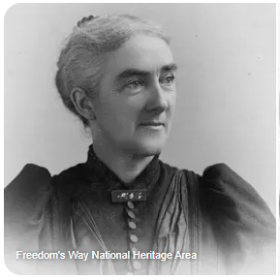
National Women’s History Month March 2024
Ellen Henrietta Swallow Richards (1842 – 1911)
First woman environmental engineer
In 1884 became an instructor in sanitary chemistry at MIT
Was a consulting chemist for the Massachusetts State Board of Health from 1872 – 1875, and the Commonwealth’s official water analyst from 1887 – 1897

Slide 7
Central Coast Chapter Shout-Outs Women of WateReuse
Shout-Outs
Gina Dorrington from Ventura Water: Wonderful combination of operations and engineering experience and a great person on top of that!
Lydia Holmes from Ventura Water: At Carollo she was the first senior executive to ever work part time while raising a family, one of our first woman shareholders, is committed to water reuse on the Central Coast (including for Ventura where she has been working for >10 years and is currently on her fourth Ventura Water GM)

Slide 8
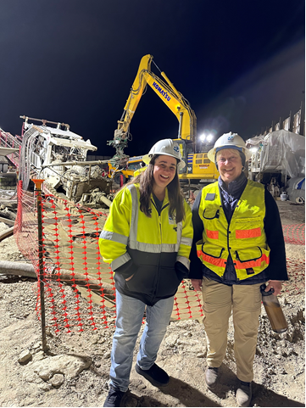
Central Coast Chapter Shout-Outs Women of WateReuse
Here’s a picture of me and Linda Sumansky, VenturaWaterPure Program Director at the installation of Ventura’s oceal outfall pipeline
-Gina

Slide 9
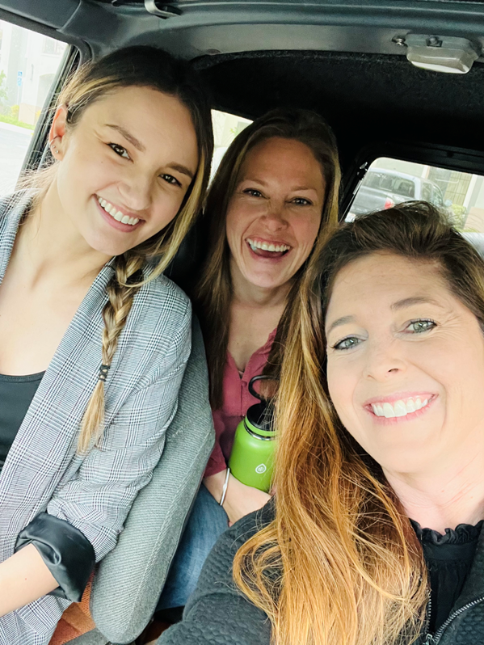
Central Coast Chapter Shout-Outs Women of WateReuse
Water/Wastewater Compliance Technician
Cara Aguiar
Water/Wastewater Operator
Carinna Ellison
Me, Carinna Ellison and Cara Aguiar on our way to the H2O Women Conference in Santa Barbara 2022.
-Shannon

Slide 10
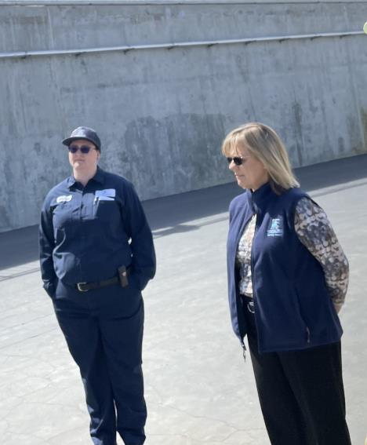
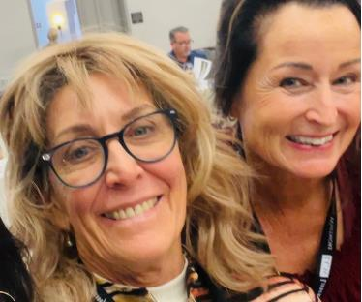
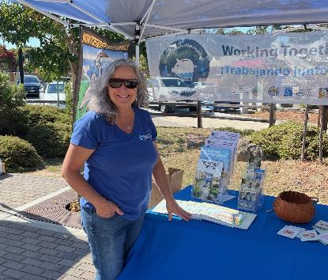
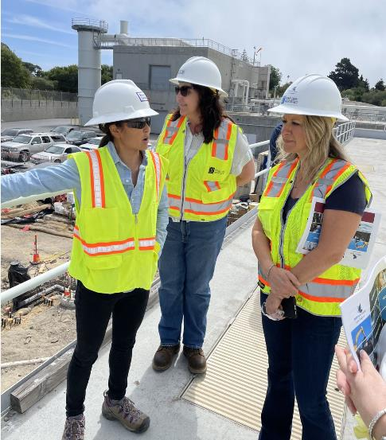
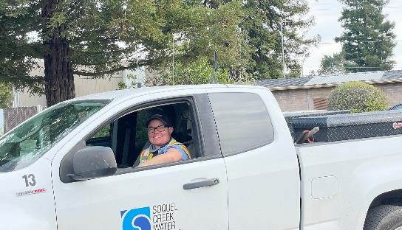
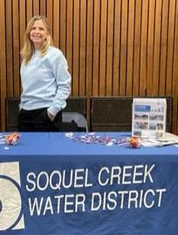
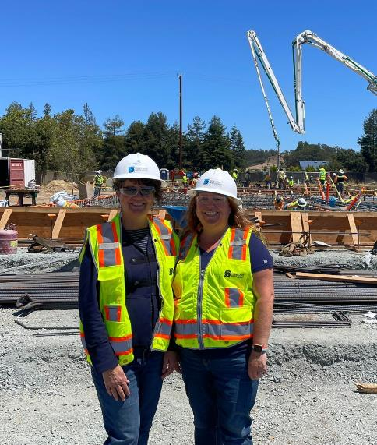
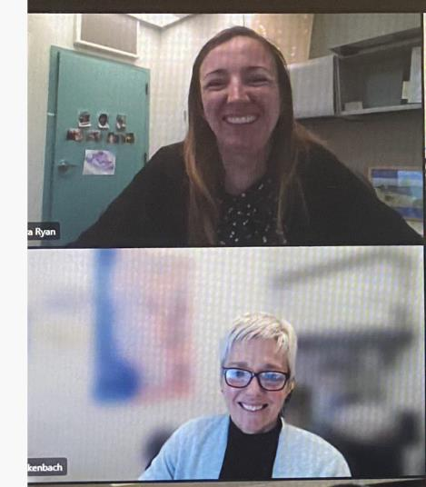

Slide 11
Legislative, Regulatory, and Funding Updates Alec Roberts aroberts@cityofventura.ca.gov

Slide 12
Leg/Reg/Funding Update: Federal & State Funding Opportunities
Notes:
Funding package for FY 2024:
$20 million for the Title XVI-WIIN Water Reuse Grants Program;
$19 million for the Desalination and Water Purification Grants Program;
Large-Scale Water Recycling Projects Competitive Grants Program, which Congress created in the Infrastructure Investment and Jobs Act of 2021, also known as the Bipartisan Infrastructure Law (BIL). The WateReuse Association helped create the program during the development and has worked extensively with BOR to guide its implementation. The program supports communities in developing large-scale water recycling projects with the high-level objective of achieving sustainable water supplies. Through this initial funding opportunity, BOR is making available $180 million out of a total of $450 million over five years. The total cost of proposed projects must be at least $500 million. Ends in Sep. 2024.
Proposition 1 provides for $625 million in funding for recycled water projects. Financial assistance is provided through Loans and grant for planning and construction activities.
Proposition 13, financial assistance through loans and grants for planning and construction activities. The funding capacity under this authority is now very limited.
Proposition 68, $72 million in loans and grants for recycled water planning and construction.

Slide 13
Leg/Reg/Funding Update: State Bills
Bill | Topic | WR | Status
AB 1845 (Calderon) | Design Build | Support | Passed
AB 2387 (E. Garcia) | Climate Bond | Watch | Inactive: Died
AB 2787 (Quirk) | Microbeads/ microplastics | Support | Inactive: Died
AB 2811 (Bennett) | Onsite reuse/ dual plumbing | Oppose Unless Amended | Active: May be heard in committee on March 17
AB 2247 (Bloom) | PFAS Source Database | Support | Inactive: Vetoed by the Governor
SB 991 (Newman) | Design Build | Support | Passed
SB 1144 (Wiener) | Water Quality/Efficiency | Support | Active: Rejected by the Governor
SB 1197 (Caballero) | Water Innovation | Support | Active: In Committee Process
SB 230 (Portantino) | CEC Program | Support | Passed
SB 12 (McGuire & Stern) | Local Government: Planning and Zoning | Watch | Inactive: Died
Notes:
SB-991–This bill authorizes a county, city, or special district that produces, stores, supplies, treats, or distributes water to use the progressive design-build method of project delivery for any public works project in excess of $5 million that treats, pumps, stores, or conveys water, wastewater, recycled water, advanced treated water, or supporting facilities.
SB 1144–: Requires state agencies and public schools to complete a water efficiency and quality assessment report on their facilities, including testing for lead, Legionella, and other contaminants. If the report identifies noncompliant plumbing fixtures and appliances or contaminants, the bill would require the operating agency to remedy the problem at the earliest practical time, subject to available funding
SB 1197–This bill would create the Initiative to Advance Water Innovation and Drought Resiliency in the Office of Planning and Research (OPR).
SB 230 This bill would require the state board to build upon its existing work dealing with, and work to improve its knowledge of, constituents of emerging concern (CEC) in water and, as part of this work, to improve its knowledge of CECs in drinking water by assessing the state of information, as specified. The bill would authorize the state board to establish, maintain, and direct a dedicated program called the Constituents of Emerging Concern in Drinking Water. Requires board to convene a Science Advisory Committee for CEC recommendations.
SB 12–This bill would require, on and after January 1, 2023, a water district, city, county, city and county, or water corporation that provides drinking water, wastewater, or recycled water, for water infrastructure projects that meet specified conditions, to use only heat-resilient water conveyance infrastructure components, as defined, in those areas designated as very high fire hazard severity zones.

Slide 14
Leg/Reg/Funding Update: Upcoming Bills
SB 903 (Skinner)
Phasing out the use of PFAS.
If approved, the bill would ban by 2030 non-essential use of PFAS in CA.
Assembly Constitutional Amendment (ACA) 13 Water Infrastructure Projects
2% of all state revenues from the General Fund diverted for water infrastructure projects
Enacts the Water Infrastructure Bond Act of 2022
Requires projects to include new or increased storage capacity, recycling of wastewater and stormwater
Funding will continue to be set aside until a minimum of 5 million acre-ft annual water storage is met.
Notes:
SB 903
This bill would, beginning January 1, 2030, prohibit a person from distributing, selling, or offering for sale a product that contains intentionally added PFAS, as defined, unless the Department of Toxic Substances Control has made a determination that the use of PFAS in the product is a currently unavoidable use
ACA 13–Water infrastructure projects:
An amendment to the State Constitution. This measure requires 2% of all state revenues be transferred to the Water Infrastructure Trust Account, and enacts the Water Infrastructure Bond Act of 2022. Projects must include new or increased storage capacity, and recycling of wastewater and stormwater, among other requirements. This funding will be set aside annually until the State has created a minimum of 5 million acre-feet of annual new water storage.

Slide 15
Leg/Reg/Funding Update: Federal Bills
Bill | Topic | WR | Status
HR 5376 (Yarmuth) | Inflation Reduction Act – Climate and Energy Package | Support | Signed into Law.
HR 7776 (DeFazio) | USACE authorization | Support | Signed into Law.
S 4231 (Feinstein) | Reuse project grants | Support | In Senate
S 4494 (Cortez Masto) | Reuse project requirements | Support | In Senate. Referred to Committee.
S 914 (Duckworth) | Water infrastructure programs | Support | In House.
S 953 (Wyden) | Funding for water-related programs | Support | In Senate.
S 2334 (Cortez Masto) | Large-Scale Recycling and Reuse Projects | Support | In Senate. Referred to Committee.
Notes:
HR 5376
The Inflation Reduction Act includes the Climate Energy Package, in which $4B goes to Bureau of Reclamation programs to help Western communities reduce water diversion and demand, limit consumptive use, and implement ecosystem restoration projects. WateReuse is working with Congress to clarify that the funding can be used to support water recycling projects.
HR 7776
This bill authorizes the U.S. Army Corps of Engineers to carry out activities concerning water resources development projects, water supply and wastewater infrastructure, flood control, navigation, or ecosystem restoration, such as shoreline restoration. In addition, it modifies the process used to deauthorize certain inactive water resources development projects. (passed house, in senate)
S 4231
To support water infrastructure in Reclamation States, and for other purposes. Bill addresses grants, desal projects and drought resilience, storage and conveyance projects, and drinking water for disadvantaged communities (introduced in senate)
S 4494
To amend the Infrastructure Investment and Jobs Act to modify the requirements for an eligible project under the competitive grant program for large-scale water recycling and reuse projects, to provide for an additional authorization of appropriations for that program, to repeal the termination of authority for that program, and for other purposes.
Amended to include (k) Authorization Of Appropriations.—In addition to the amounts made available to carry out this section under section 40901(4)(B), there is authorized to be appropriated to carry out this section $500,000,000, to remain available until expended.”.
(bill introduced in senate)
S 914
This bill reauthorizes through FY2026 or establishes a variety of programs for water infrastructure. Specifically, it supports programs to provide safe drinking water or treat wastewater, such as sewer overflows or stormwater. For example, the bill reauthorizes and revises the clean water state revolving fund (SRF) and the drinking water SRF. (passed senate)
S 953
This bill establishes a funding source for certain water resources development projects in western states. The bill also reauthorizes and expands existing water resources development programs, as well as establishes new programs.Specifically, the bill establishes the Bureau of Reclamation Infrastructure Fund to fund water-related programs, including water reclamation and reuse projects, dam safety projects, and the WaterSMART program (which provides assistance to eligible government entities to increase water supply). Each year from FY2031-FY2061, the Department of the Treasury must deposit $300 million of revenues into this fund that would otherwise be deposited into the Reclamation Fund (which currently funds irrigation works in western states).
The bill also expands the allowable uses for grants under the WaterSMART program.
Next, the bill revises the Reclamation Climate Change and Water program (which assesses the impact of climate change on water supplies) by requiring Reclamation to develop a strategy to address sustaining native biodiversity during periods of drought.
The bill also reauthorizes through FY2028 the Fisheries Restoration and Irrigation Mitigation program (which funds fish passage projects in certain areas that drain into the Pacific Ocean).
Finally, the bill establishes new programs directed at western states to
provide assistance to agricultural producers to create and maintain waterbird and shorebird habitats,
award grants to eligible government entities and nonprofit conservation organizations for habitat restoration projects that improve watershed health, and
prepare plans to sustain the survival of critically important fisheries during periods of drought.
(Introduced in Senate)
S 2334
This bill requires the Department of the Interior to award grants to water or power delivery authorities for the planning, design, and construction of large-scale water recycling and reuse projects in drought-stricken regions of certain Western states.
The bill includes emergency drought planning as a watershed management project under the Cooperative Watershed Management Program.
Financial assistance may be made available under the Reclamation States Emergency Drought Relief Act of 1991 for eligible water projects to assist Western states and tribal governments to address drought-related impacts to water supplies or any other immediate water-related crisis or conflict.

Slide 16
Leg/Reg/Funding Update: Regulatory Update
Direct Potable Reuse (DPR) Regulations
Regulations were adopted unanimously on December 19, 2023, by the Water Board.
It is anticipated that the regulations will become effective in early summer of 2024.
On-Site Reuse
SWRCB is in the process of developing risk-based water quality standards for the onsite treatment and reuse of non-potable water for multifamily residential, commercial, and mixed-use buildings (AB 2811).
Staff plans to submit the Notice of Proposed Rulemaking to the OAL to start the rulemaking process by Spring 2024 with a projected board adoption in Fall 2024.
WRCA opposes AB 2811 unless amended due to a lack of coordination with water and sanitation agencies and potential disruption of existing planning efforts.
Notes:
DPR Current Steps:
Submission of rulemaking file to the Office of Administrative Law (OAL)
Approval by OAL
Filing with the Secretary of State
Signing of the regulations by the Secretary of State, making them effective
Onsite Reuse:
The state board shall address in those regulations, at a minimum, all of the following:
(1) Risk-based log reduction targets for the removal of pathogens such as enteric viruses, parasitic protozoa, and enteric bacteria for non potable water sources, grey water, rainwater, stormwater, and blackwater, and non potable end uses, toilet and urinal flushing, clothes washing, irrigation, and dust suppression.
(2) Water quality monitoring requirements.
(3) Reporting requirements for the water quality monitoring results.
(4) Notification and public information requirements.
(5) Cross-connection controls.
Pursuant to Water Code subsections 13558(c) and (d), the risk-based water quality standards will not address untreated graywater systems that are used exclusively for subsurface irrigation and untreated rainwater systems that are used exclusively for surface, subsurface, or drip irrigation.
Existing onsite treated non potable water systems in operation before the effective date of the regulations will be required to comply with the regulations within two years of the effective date.
“WRCA opposes AB 2811 (Bennett) unless the portion of the bill addressing onsite reuse is amended. The measure requires the Water Board by 2025 to mandate the installation of onsite reuse systems for large commercial properties without consultation or coordination with water or sanitation agencies.”
WRCA argues that this collaboration is crucial to developing sustainable supplies. They believe this is premature as local programs for onsite reuse are already being developed through SB 966.WRCA claims that the mandate in AB 2811 will siphon off wastewater, making it difficult for local agencies to plan for future water projects, including potable reuse. Therefore, WRCA requests that the onsite reuse portion of AB 2811 be revised or removed.

Slide 17
Agency Roundtable/California WateReuse Monthly Newsletter Input Steve Thomas

Slide 18
Today’s Presentation/Discussion
Water Reuse During Times of Above-Average Precipitation
Steve Wait, GHD

