Slide 1
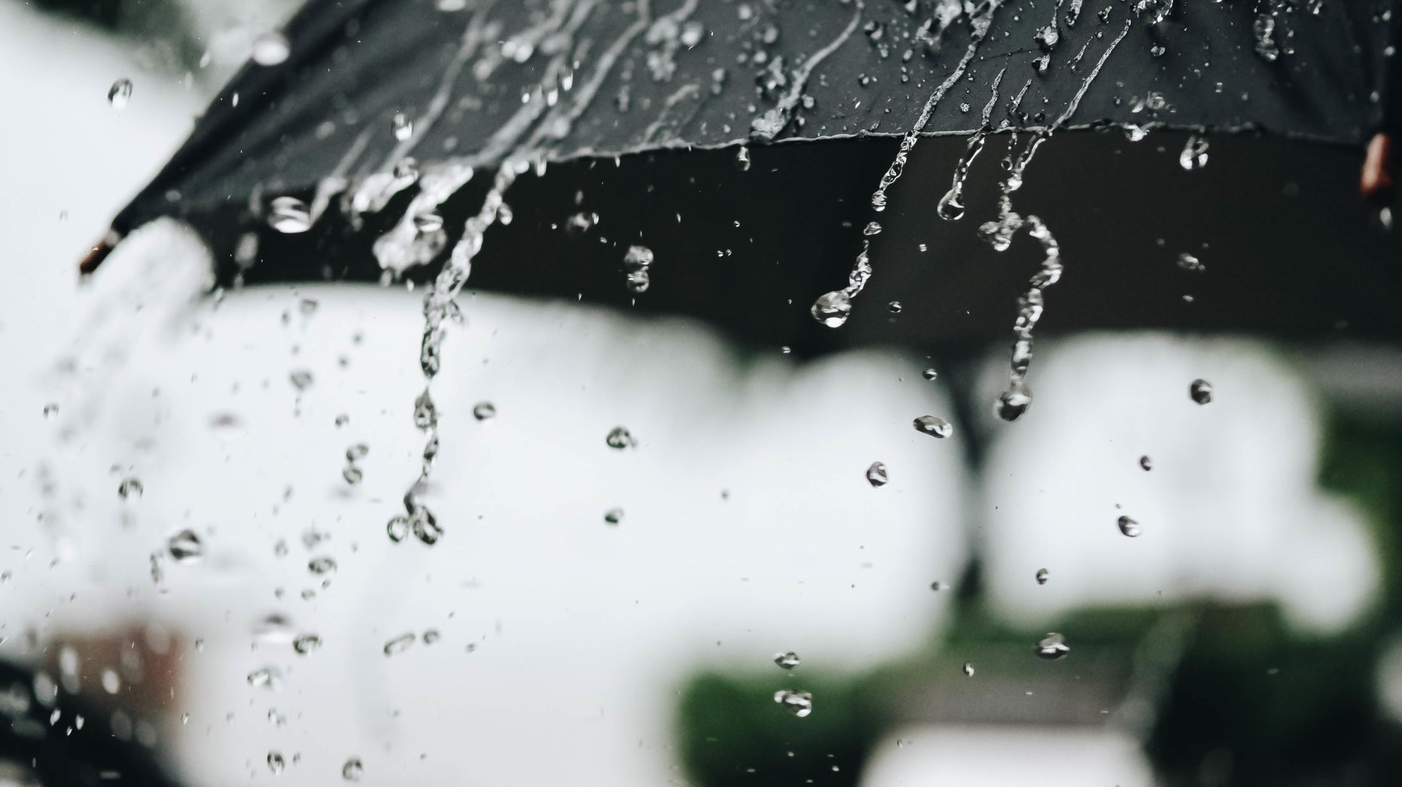
How to “sell” a water reuse project during a rainstorm

Slide 2
What Does a Drought Really Mean?
Problem (s)
The public sees droughts can be ended by a storm or even 1-2 years of a wet winters
The public does not fulling understand their source of drinking water sources, so they cannot relate to sustainable
Solution
Arm elected officials with the correct ideas to talk about water supply diversity (nothing new for this group)
Concept ideas:
During a drought, short term Surface water supply's are in jeopardy, so more Groundwater is used
Concept of overdraft checking and dipping into savings to pay bills for years, yet 1-2 years of good income cannot immediately resupply your savings
Weather Whiplash, new term?
Hydrologic Drought vs the normal drought
Data / graphics of common Drought graphics explained
The Drought Monitor data looks a surface water as it is easy to measure, but qualify long-term groundwater supply’s
Soil Moisture data is from 20 cm of soil =are not long terms prediction tools

Slide 3
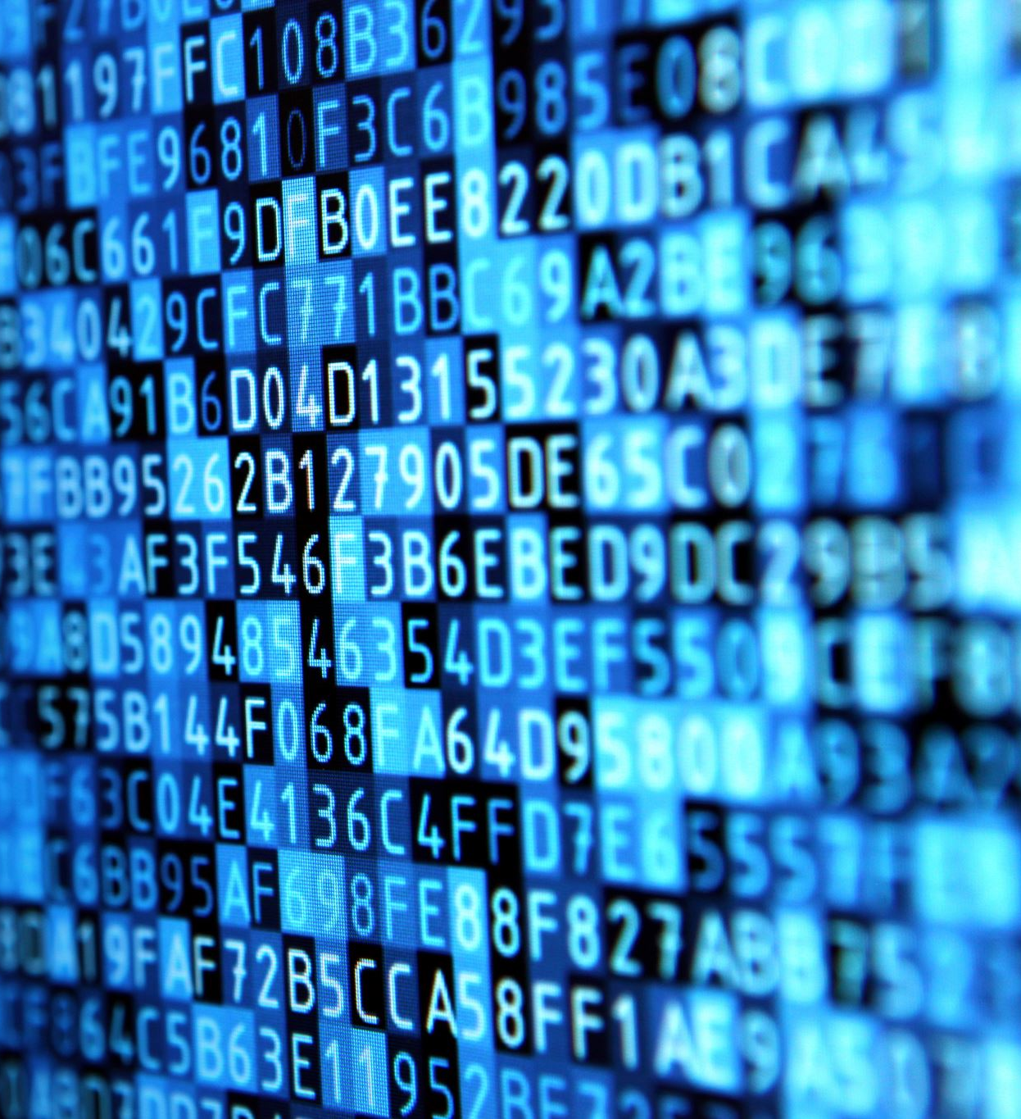
Facts, Information, and Messaging

Slide 4
Atmospheric Rivers: How They Affect Water Supply
Messages:
Lots of rain does not equal groundwater storage
70-80% goes to ocean: depends on location, watershed development, but in general a larger % then most people believe
Soil Hydraulics and percolation and saturation effect on rainfall capture: Highly dependent on location
Massive storms are not as needed as steady amount of rain (in terms of ease of storage and recharge potential)

Slide 5
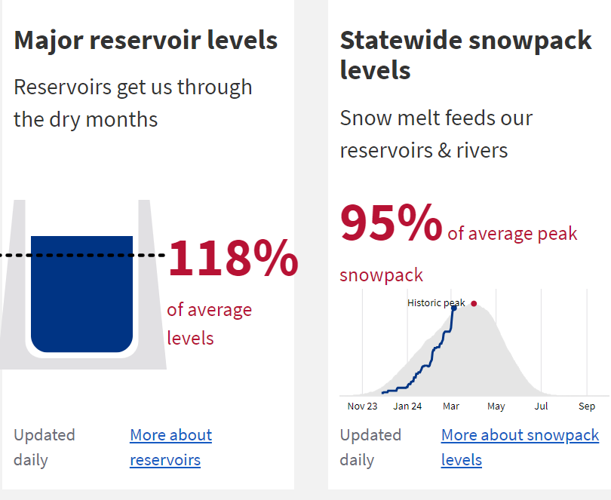
Surface Water Flows
Messages:
1. Across the board, surface water is highest since 2014
2. Snowpack is 95% of average peak
3. Reservoirs are above running average
= Drought Over?

Slide 6
Surface Storage update
Messages:
We are saved! The drought is over
Water Supply Reservoirs are at or near capacity
Long-term storage and reliability is still vulnerable when the next drought comes
= Drought Over?

Slide 7
Groundwater Well Summary
Messages:
Groundwater is still under stress in most areas of CA
Central Valley is very much still under stress
Portions of the Central Coast still are under stress of groundwater Shortages
= Drought Over?

Slide 8
Ground Water Decreasing in Health: Bad News
Messages:
More rain = less demand on ground water
But does not recharge ground Water fast as public thinks: Ground water is old surface water
Data showing in past three year running average groundwater deficit

Slide 9
Dry Wells Reported

Slide 10
Other Reasons to Justify (aka Sell) Water Reuse Projects
Beyond the messages that droughts are episodic and water supply Diversity is a wise choice.
Diversification and reliability are key factors in long term planning
Environmental protection of the water supply: Reuse is the safest water around!
Saltwater intrusion/subsidence with groundwater basin protection
Cost effectiveness and affordability when compared to other options
Regulatory and statewide requirements (Recycled water gets the 10% credit)

Slide 11
Tool Kits/ Data Sources / Resources
California | Drought.gov
California Water Watch
California Data Exchange Center
San Joaquin Valley, CA (weather.gov)
West | U.S. Drought Monitor (unl.edu)
Drought Communication Toolkit | CDC
Acknowledgments:
Special thanks to Melanie Mow Schumacher of Soquel Creek Water District and Ben Fine of Pismo Beach

