Slide 1
Pajaro Valley Water Management Agency Agriculture Irrigation Reuse Program & Tour of City of Watsonville/PV Water Recycled Water Facility Shinehah Bigham Operations and Maintenance Manager Marcus Mendiola Water Conservation & Outreach Specialist
Notes:
Touch on 3 themes today:
Perseverance: the long slog… through lawsuits, uncertain submittals (BMP)
Collaboration: We can do it better, together (Community, Agencies, Academics, Consultants, Funders (i.e., DWR, SWRCB, BoR)
Optimism: Believe we can get it done

Slide 2
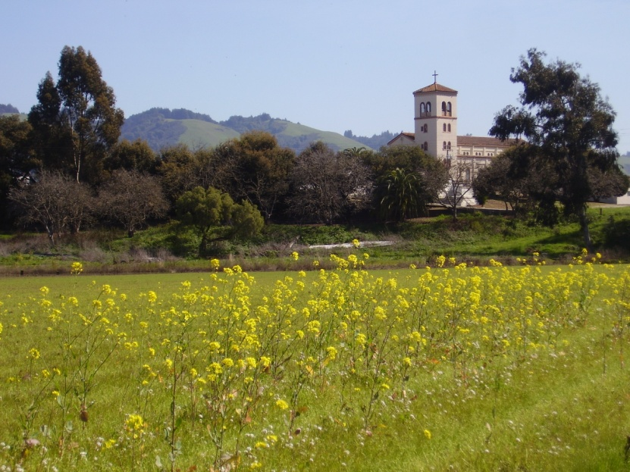
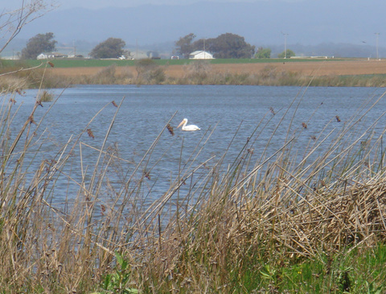
Presentation Overview
Background/State of the Basin
Delivering Recycled Water to Agricultural Customers
Recycled Water Facility Tour

Slide 3
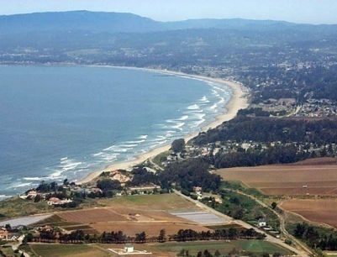
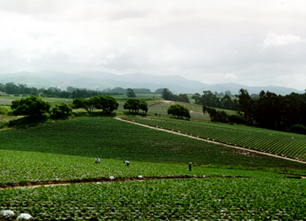
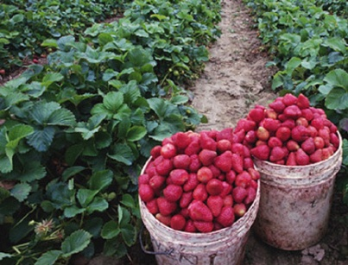
Pajaro Valley Water Management Agency
Special District formed by the CA State Legislature in 1984
Goals: Achieve Sustainable Groundwater Resources, Maintain Agriculture
Multi-jurisdictional: City of Watsonville, parts of Santa Cruz, Monterey and San Benito Counties
Basin Management Planning, Well Metering, Hydrologic Modeling, Supplemental Water, Conservation

Slide 4
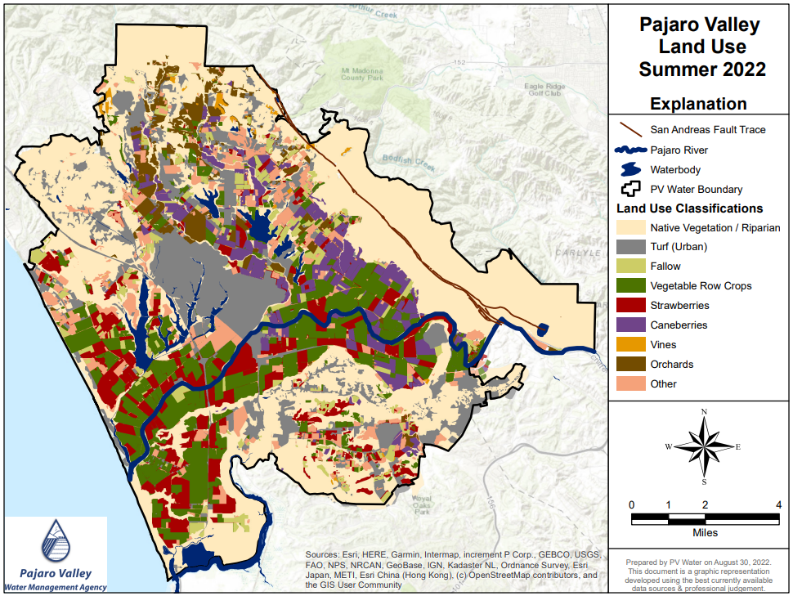
Ag-Economy
>28,000 Irrig. Acres
Est. Crop Value
~ $1 Billion
Notes:
Value of Ag Production was around $800 Million in 2012

Slide 5
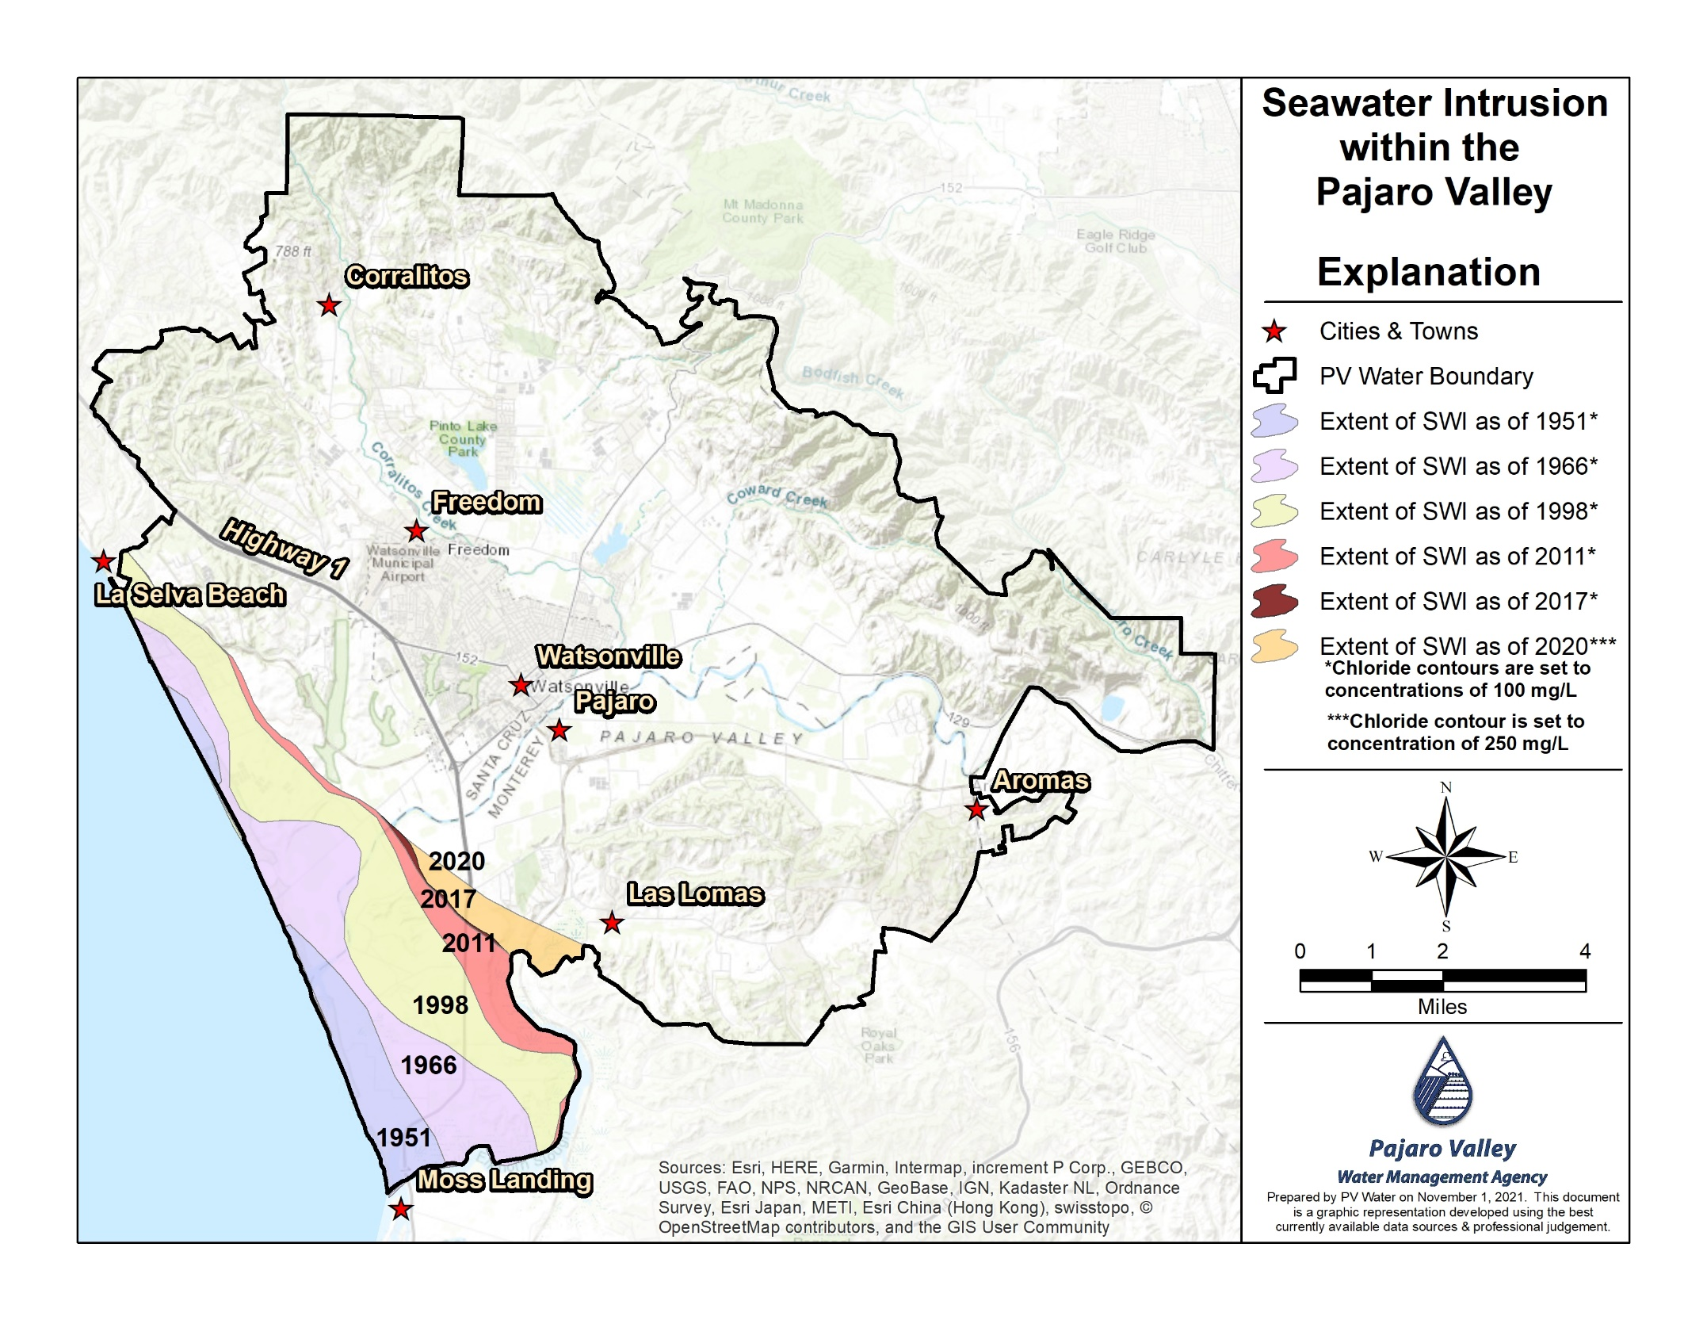

Slide 6
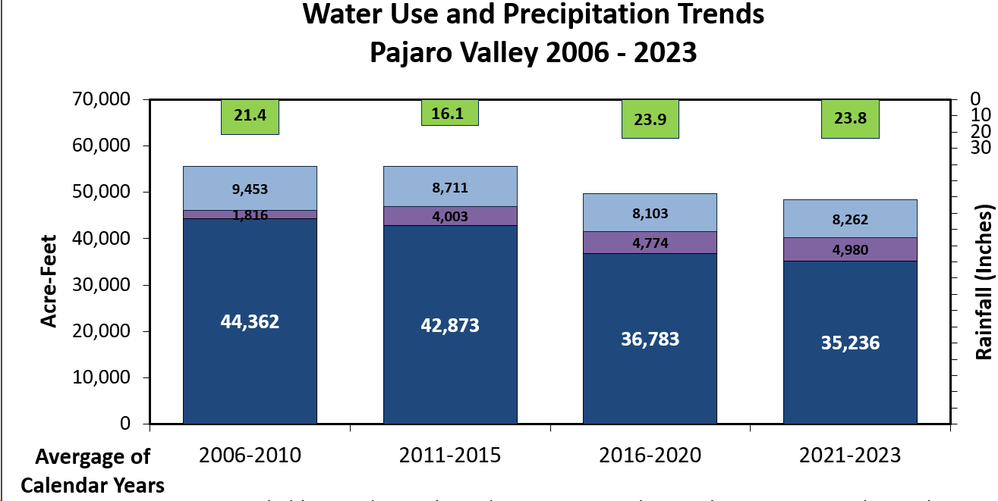

Slide 7
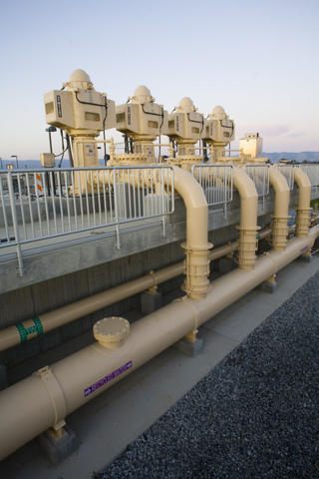
Existing Water Supply Facilities to Reduce Overdraft & Seawater Intrusion
Harkins Slough Facility
Managed Aquifer Recharge & Recovery
Stream flow diversion
10,000 AF recharged since 2002
Recycled Water Facility
4,000 AFY irrigation season capacity since 2009
Drought tolerant supply
Reduces discharge of secondary effluent to marine sanctuary
Coastal Distribution System
Over 23 miles of water conveyance pipeline
Blend Supplies

Slide 8
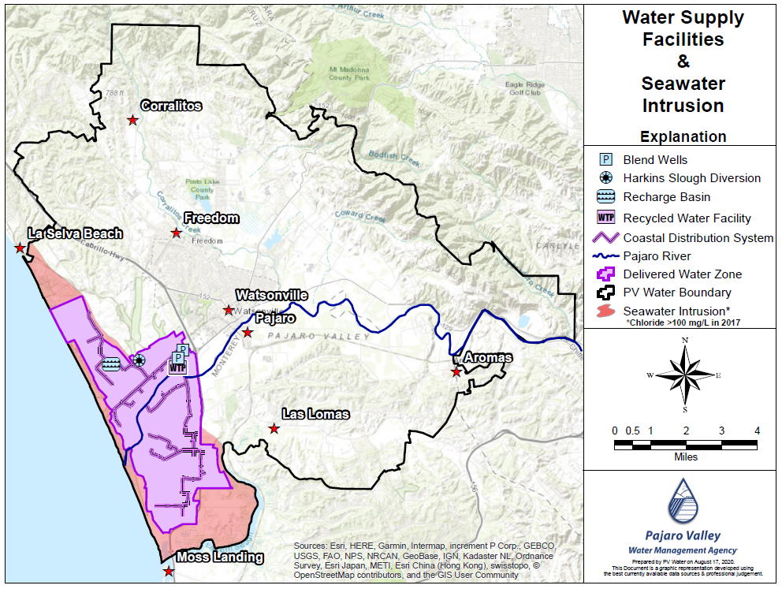
Notes:
Five year average groundwater production (2006-2010) in the DWZ ~8,000 AFY.
DWZ total water use is ~10,000 AFY

Slide 9
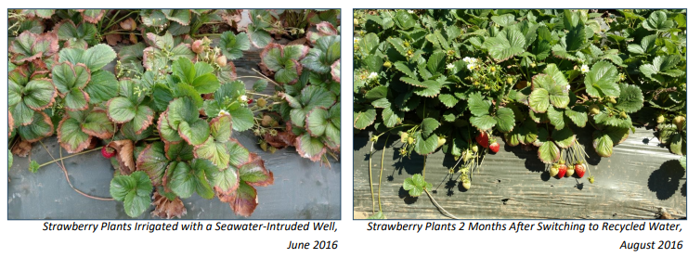
The Visible Agroeconomic Benefit to Recycled Water

Slide 10
Increasing Recycled Water Deliveries
BMP Update, 2014

Slide 11
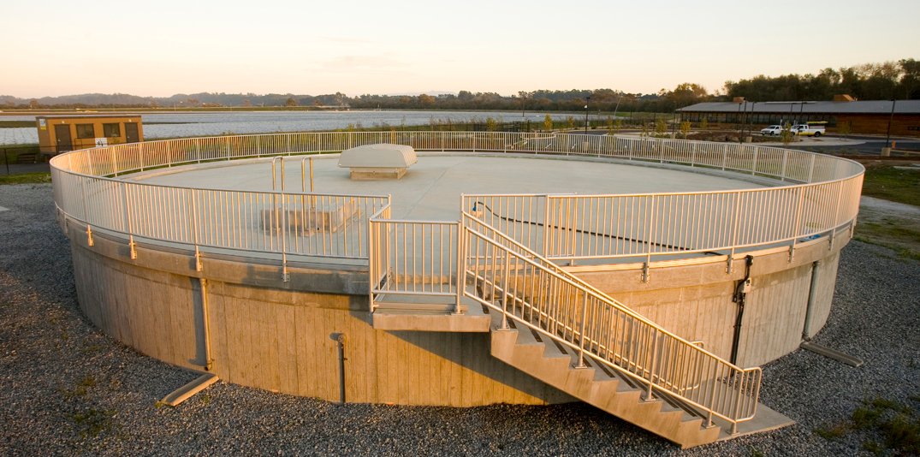
Increased Recycled Water Storage & Pump Station Improvements
Existing 0.5 MG Tank
Grant Funded Project
$6 Million project largely funded by State and Federal Grants
New 1.5 MG Tank Under Construction in 2016

Slide 12
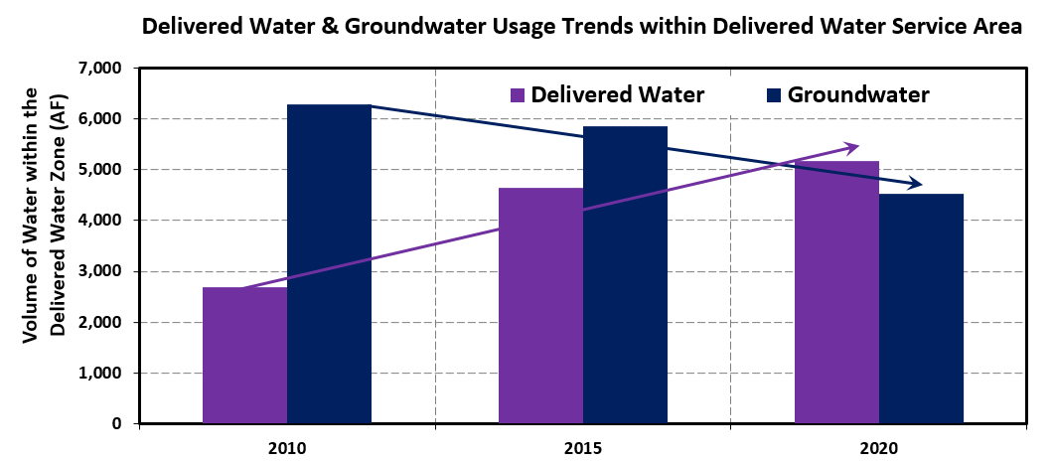
Water Deliveries and Groundwater Production

Slide 13
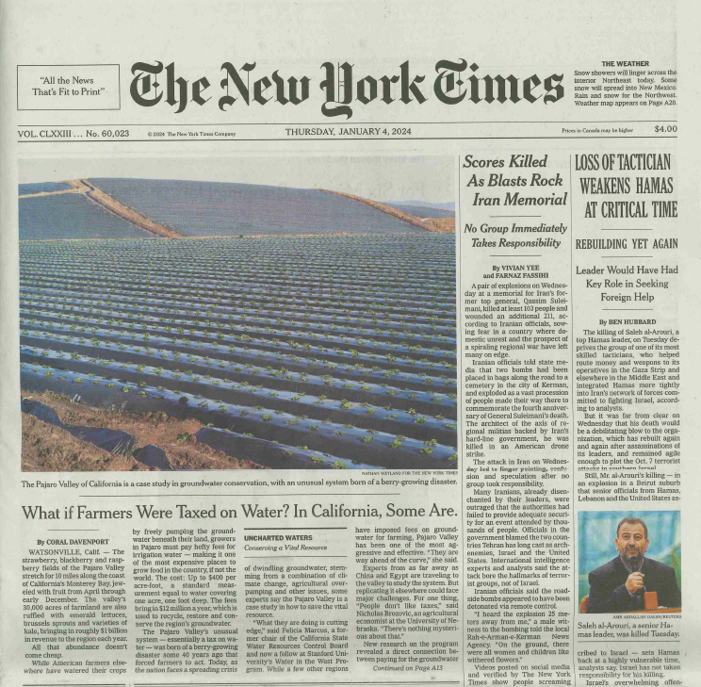
National Coverage Pajaro Valley featured in New York Times series on Groundwater in the United States, January 4, 2024
https://www.nytimes.com/interactive/2023/12/29/climate/california-farmers-water-tax.html

Slide 14
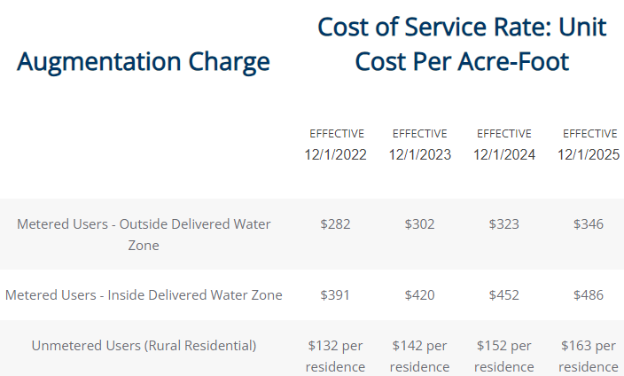
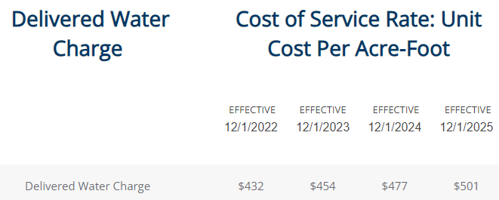
Rates to Fund Management Actions

Slide 15
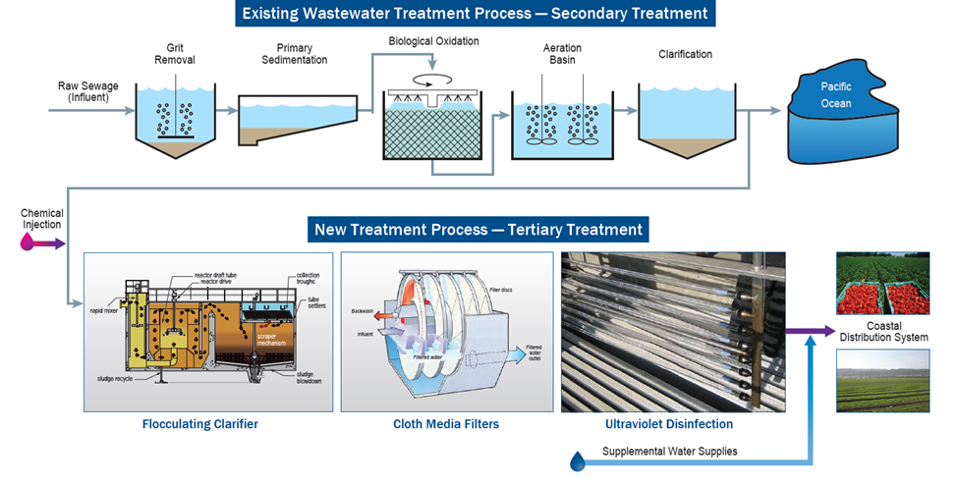
Recycled Water Facility – Tertiary Treatment

Slide 16
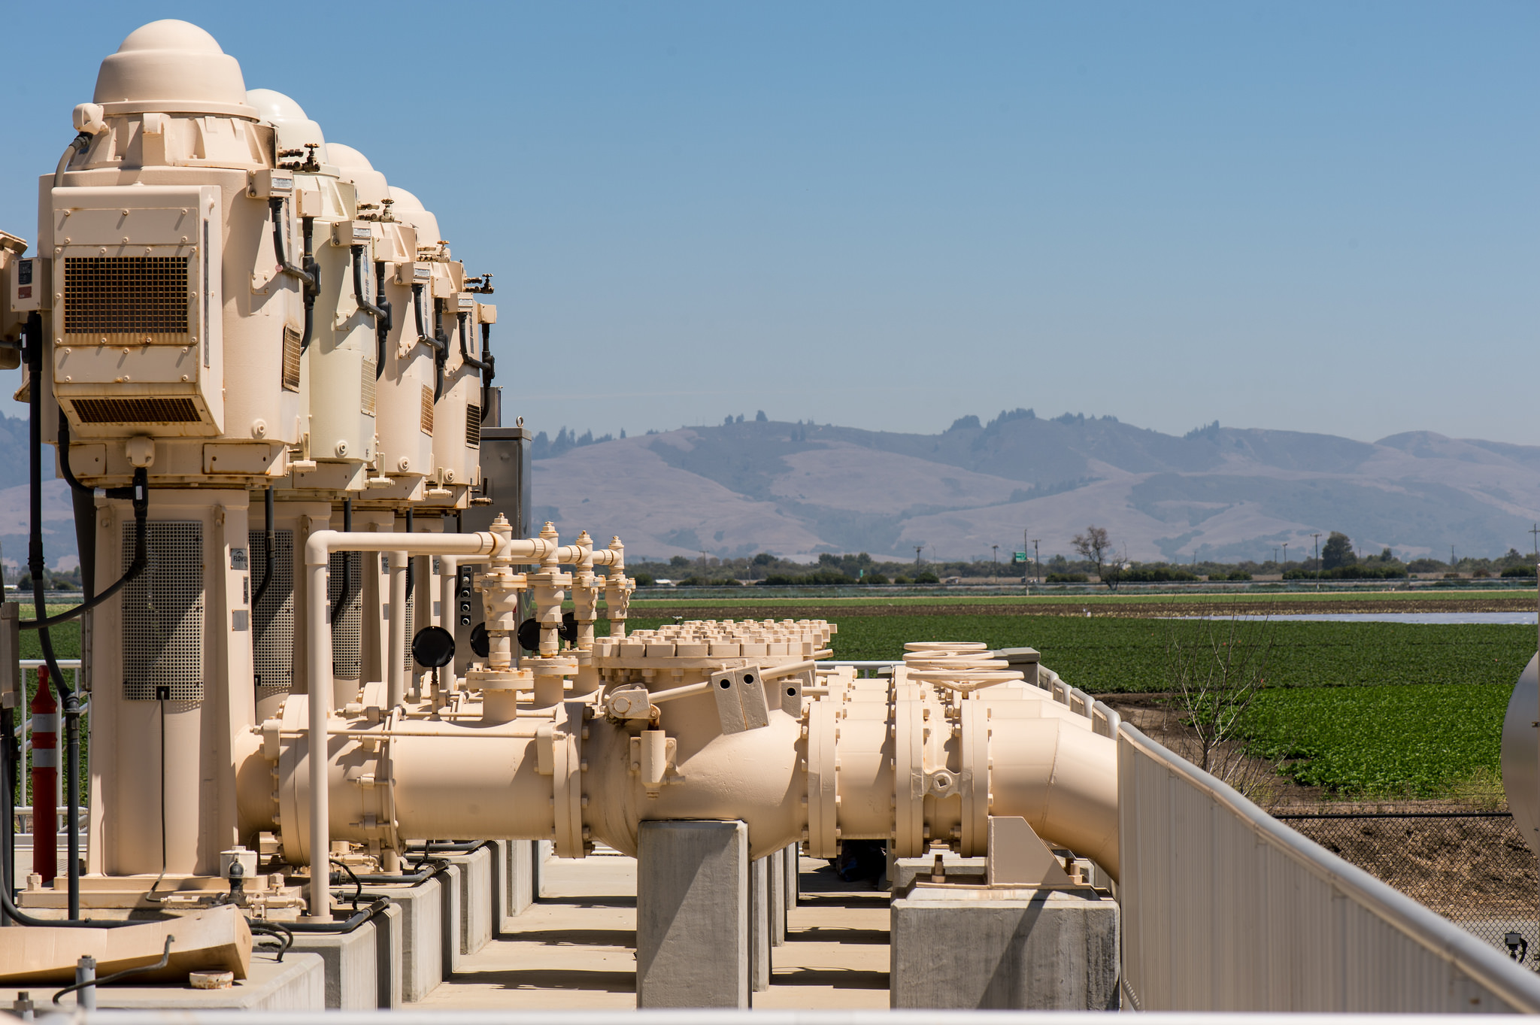
Thank you. Comments / Questions? Visit our website: pvwater.org Email: bigham@pvwater.org mendiola@pvwater.org

