Slide 1
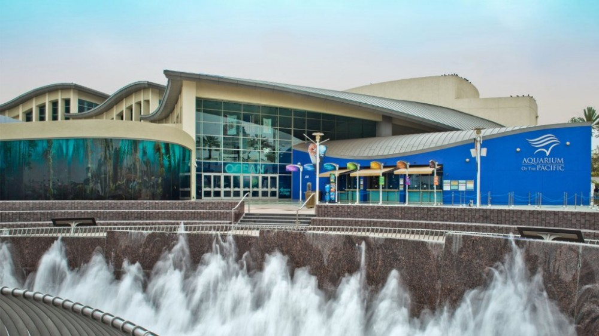
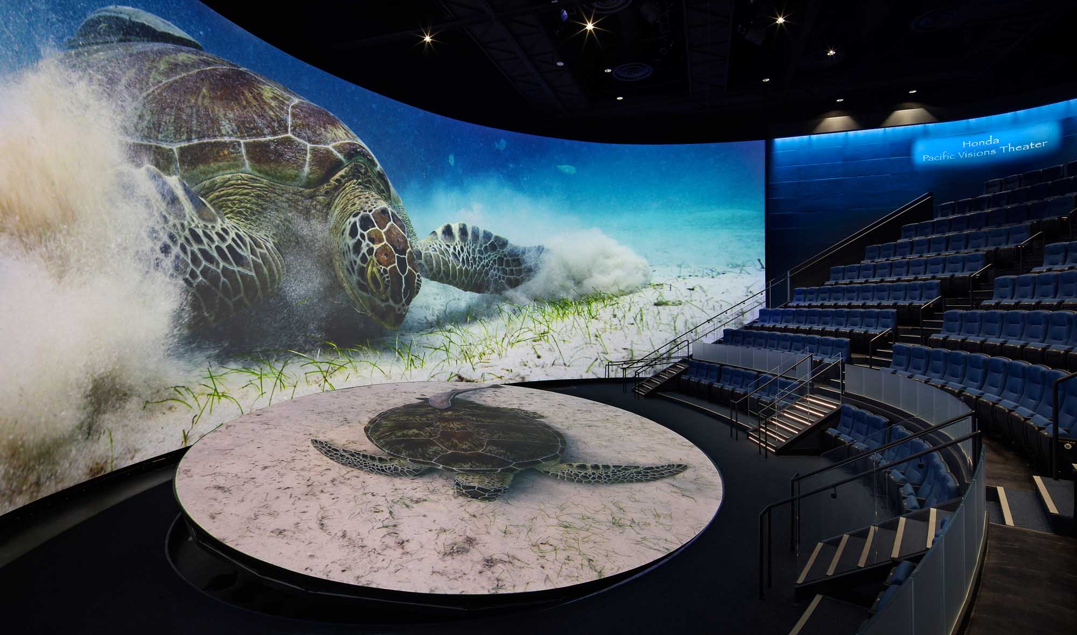
Save the Date! Los Angeles and Orange County WateReuse Summit Ripple Effect: Recycle, Recharge, Repeat! October 8, 2024 11 am – 3 pm Long Beach Aquarium of the Pacific 100 Aquarium Way Long Beach, CA 90802 Pacific Visions Auditorium Capacity of 190 Attendees!
Featuring:
Expert panel discussion
Presentations by local reuse leaders
Networking opportunities
Complimentary parking and lunch!

Slide 2
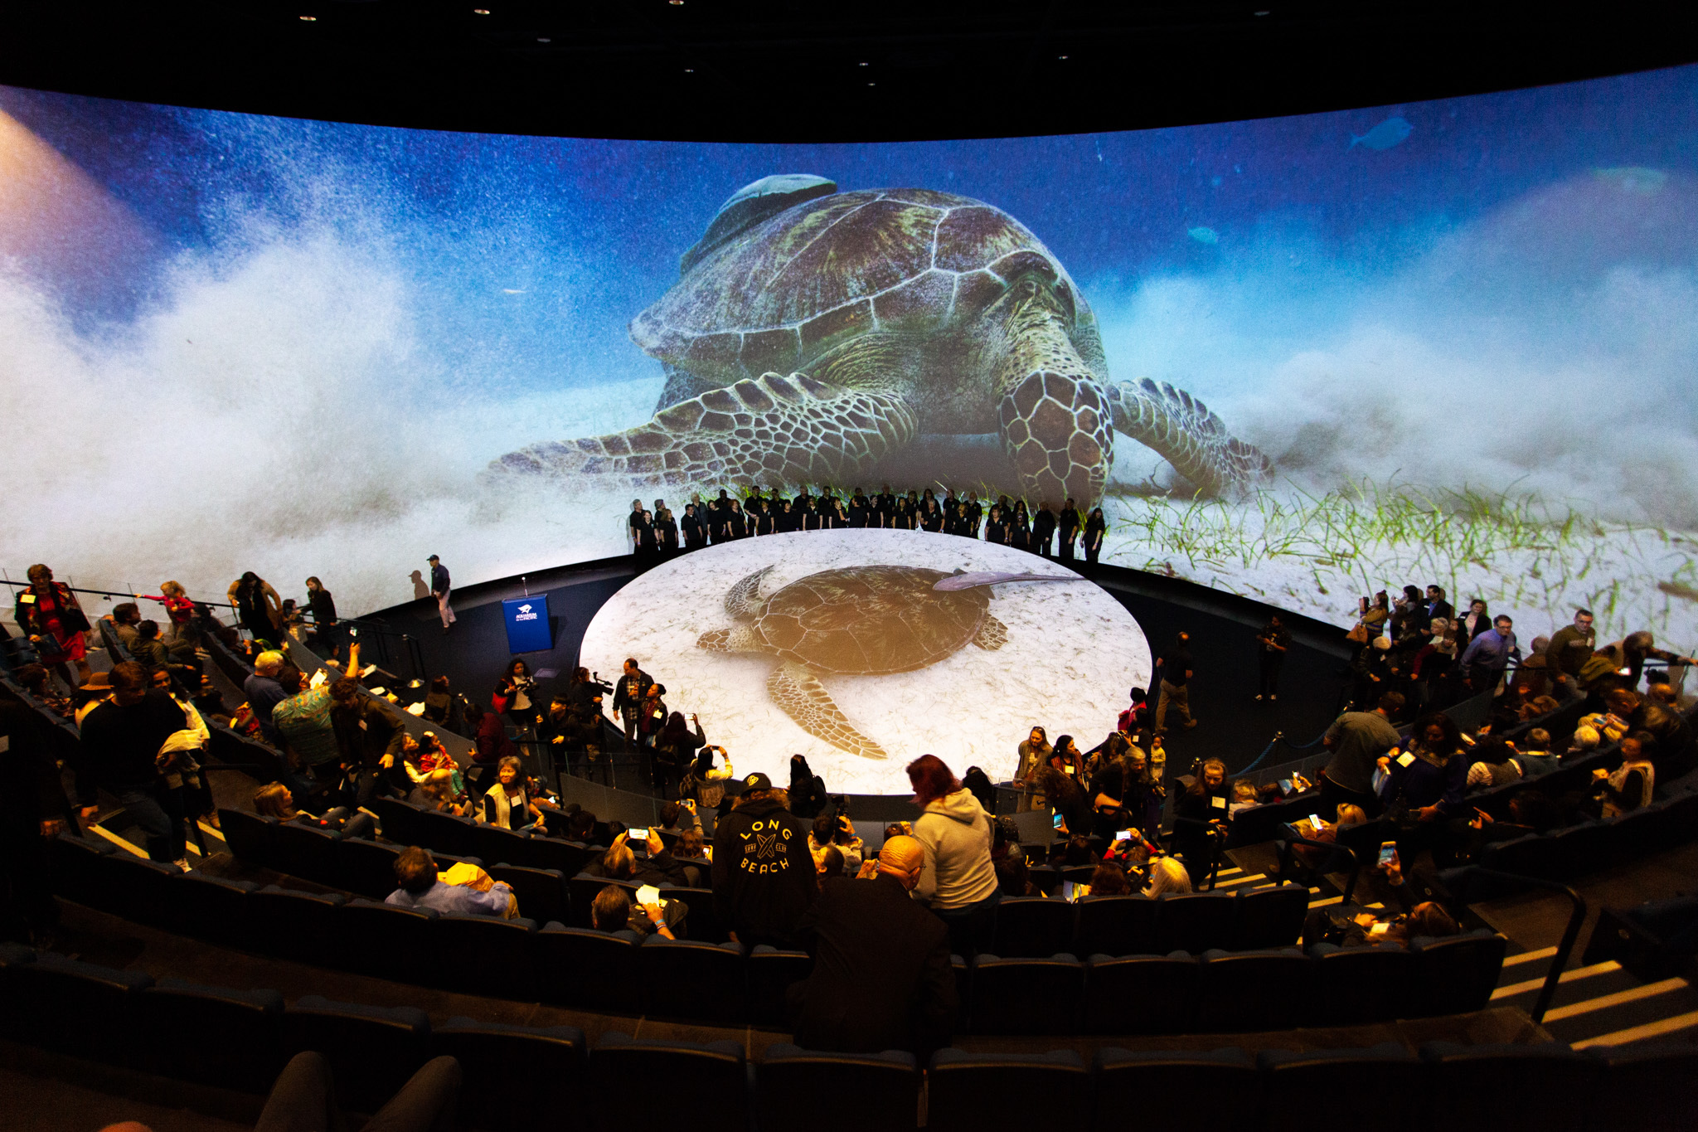
Don’t Miss the Opportunity to Sponsor!
Los Angeles and Orange County WateReuse Summit
Blue Whale Sponsorship $1000
20-minute presentation on water reuse topic
Company/agency logo on event flyer, handouts, and intro slides
Limited slots remaining! Must respond by August 23, 2024
Dolphin Sponsorship $500
Company/agency logo on event flyer, handouts, and intro slides
Contact Alex Waite (alex.waite@santamonica.gov) or LA & OC chapter board member for more information.
Your Logo Here

