Slide 1
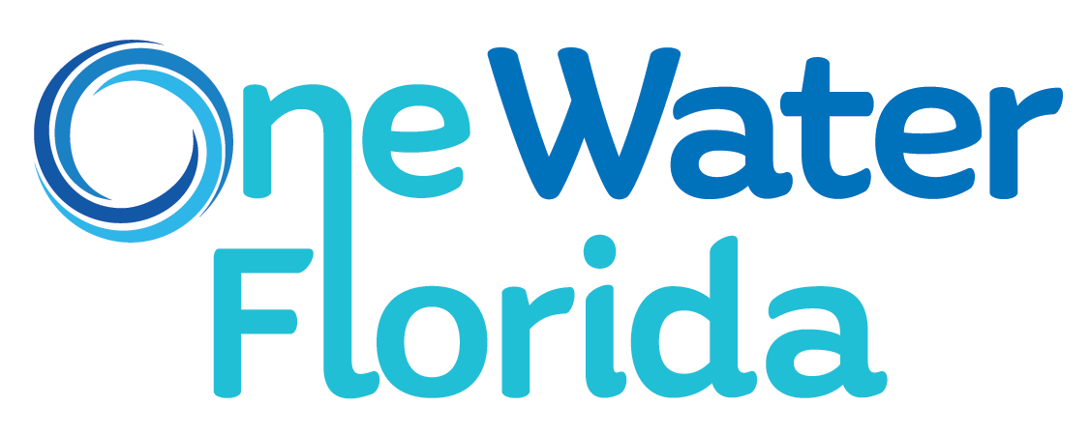
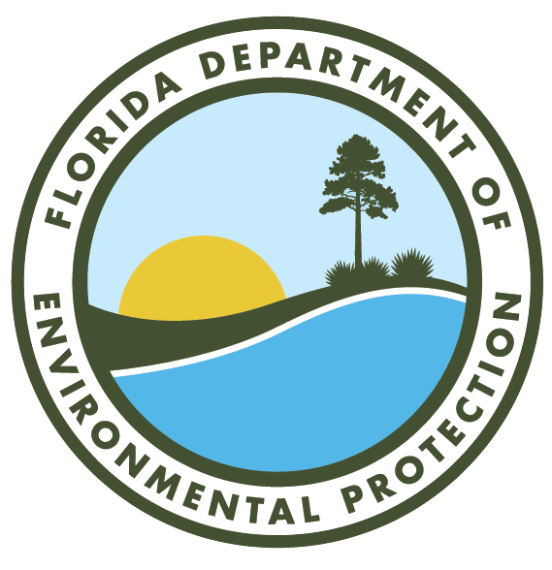
Notes:
Today’s presentation is going to discuss:
What is potable reuse?
Why does Florida need it?
What are the benefits?
How is the state moving forward?

Slide 2
What is Potable Reuse?
Highly treated recycled water from various sources people can use for drinking, cooking or bathing
Meets or is a higher quality than strict state and federal drinking water standards
Proven technology to make the water safe
Notes:
What is Potable Reuse?
Highly treated recycled water from various sources people can use for drinking, cooking or bathing
Meets or is a higher quality than strict state and federal drinking water standards
Proven technology to make the water safe

Slide 3
Florida’s Water Supply
Floridians use nearly 6.4 billion gallons of water per day
Estimated 1,000 people moving to the state daily
Need an additional 1 billion gallons of water per day by 2040
Our supply is not endless
Notes:
So why do we need potable reuse?
Floridians use nearly 6.4 billion gallons of water per day
Estimated 1,000 people moving to the state daily
Need an additional 1 billion gallons of water per day by 2040
Our supply is not endless

Slide 4
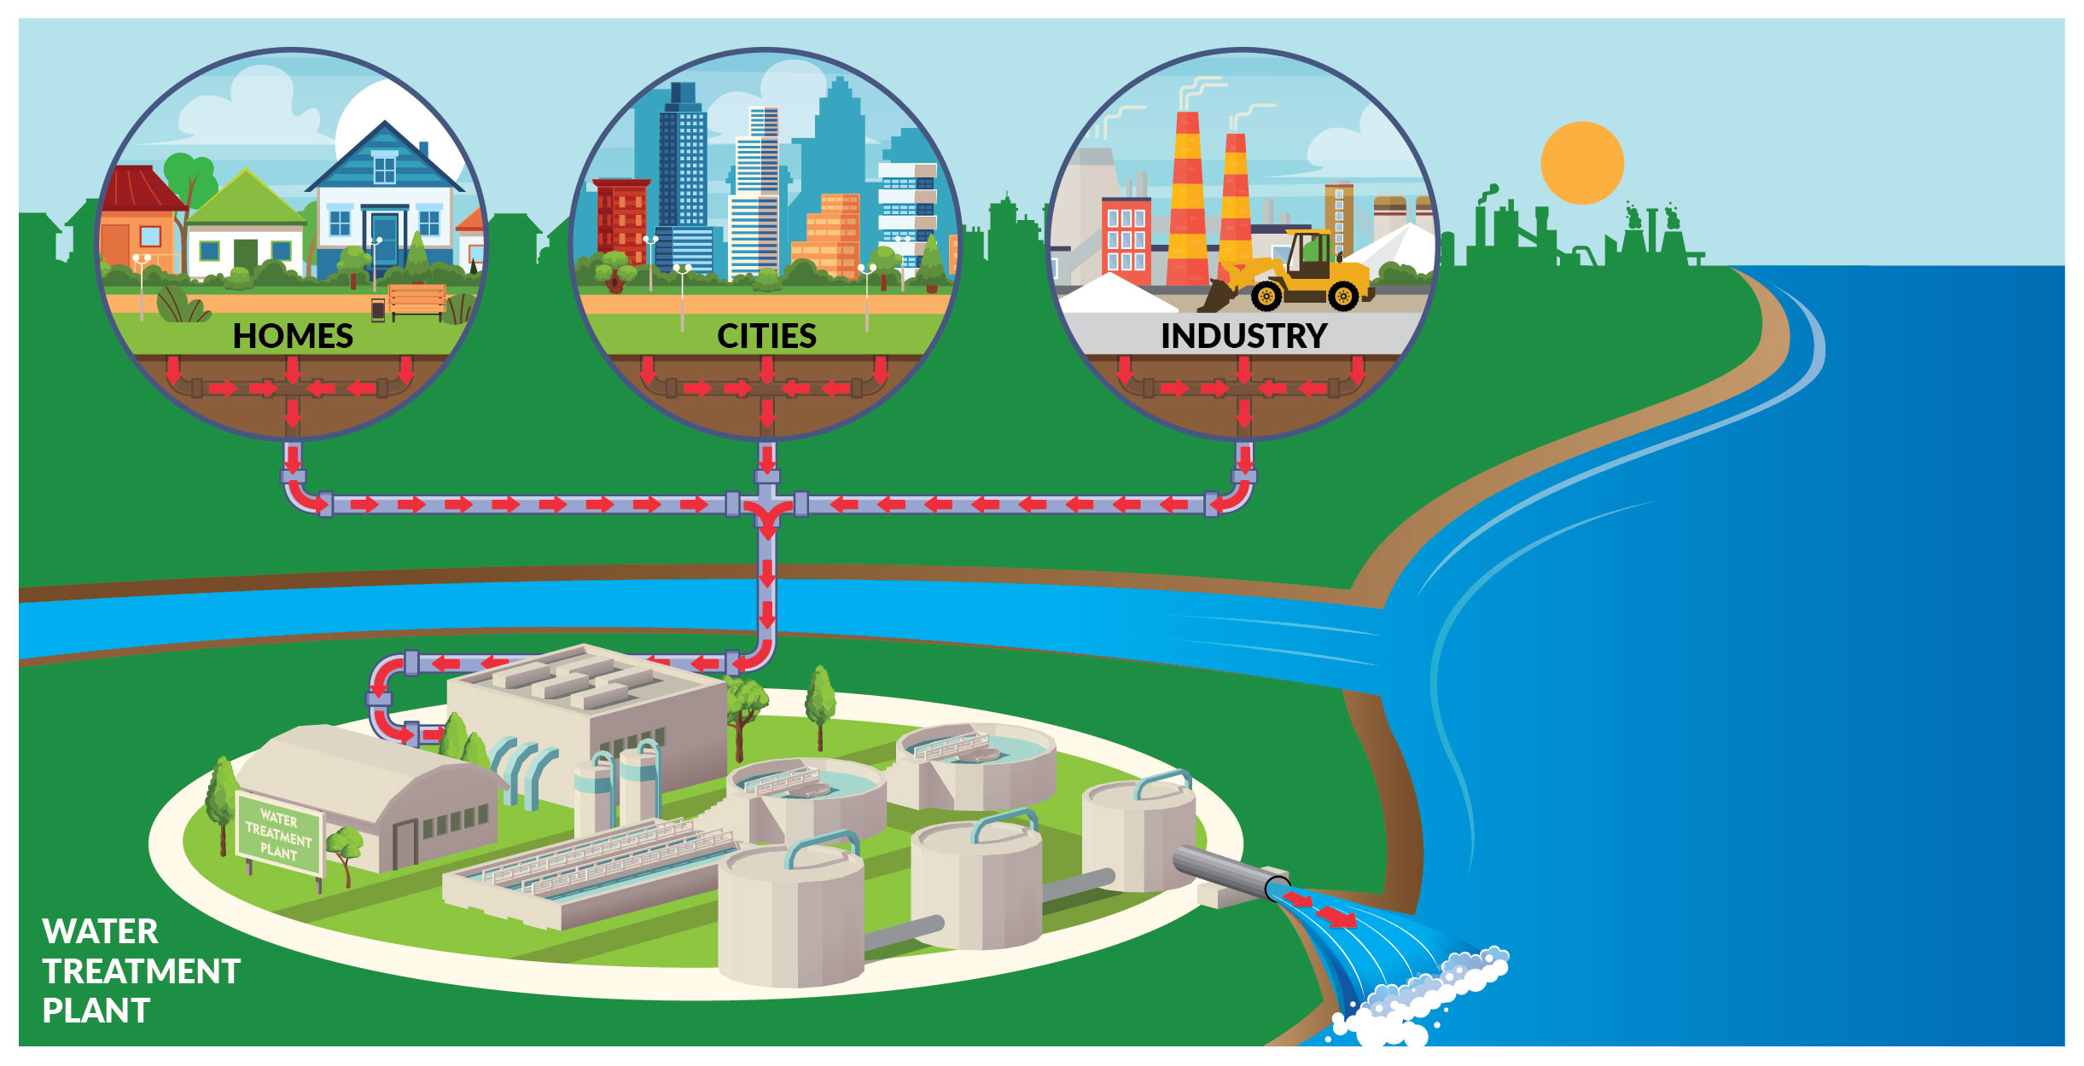
Supplying Florida’s Demand
Notes:
Expanding the use of recycled water is one way we can help ensure there is plenty of water to meet this demand.
More than 830 million gallons of treated water per day are disposed into Florida’s surface water bodies or deep disposal wells as illustrated here. This is something Florida is moving away from.
Through advanced treatment and continued conservation efforts, this unused source could supply Florida with most of its projected water needs.

Slide 5
Indirect and Direct Potable Reuse
Notes:
There are two types of potable reuse: indirect and direct.
Indirect potable reuse is highly treated wastewater that receives additional natural treatment in an aquifer or a wetland, then is withdrawn and treated all the way to drinking water standards and sent directly to home and businesses for all purposes.
Direct potable reuse is wastewater that is treated all the way to drinking water standards and then sent directly to homes and businesses for all purposes.

Slide 6
Process to Treat Recycled Water (Direct)
1. Goes through multiple advanced pretreatment processes, aeration and nutrient removal
2. The water receives additional filtration to remove microorganisms, including viruses, bacteria and other pollutants
3. Protection through advanced disinfection treatments such as ultraviolet light, ozone and peroxide to ensure high-quality drinking water
Notes:
How is this type of recycled water purified and treated? Let’s look at the direct treatment process for an example.
First, the water goes through multiple advanced pretreatment processes, aeration and nutrient removal
Next, the water receives additional filtration to remove microorganisms, including viruses, bacteria and other pollutants
Last, protection through advanced disinfection treatments such as ultraviolet light, ozone and peroxide to ensure high-quality drinking water

Slide 7
Making Sure Water is Safe
Highly trained and certified water treatment operators maintain safe, functioning water systems in Florida
Florida Department of Environmental Protection (DEP) ensures utilities provide safe, reliable water to Floridians
Ensures that water utilities provide safe, reliable drinking water to Floridians, including those using recycled water
Notes:
Is the water safe for people to drink? The answer is yes. This type of recycled water uses proven technology to make the water safe.
Who is responsible for making sure water is safe to drink in Florida: Highly trained and certified water treatment operators maintain safe, functioning water systems in Florida.
The Florida Department of Environmental Protection takes its responsibility seriously to ensure the water utilities provide safe, reliable drinking water to Floridians, including those using recycled water.

Slide 8
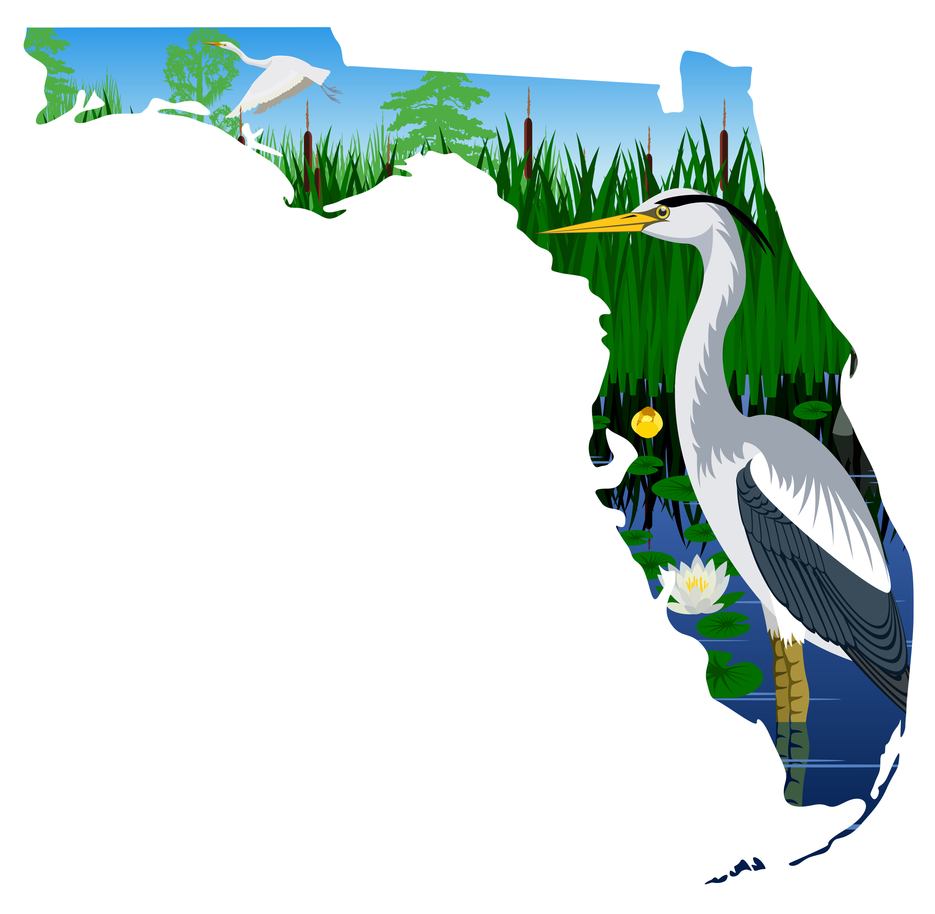
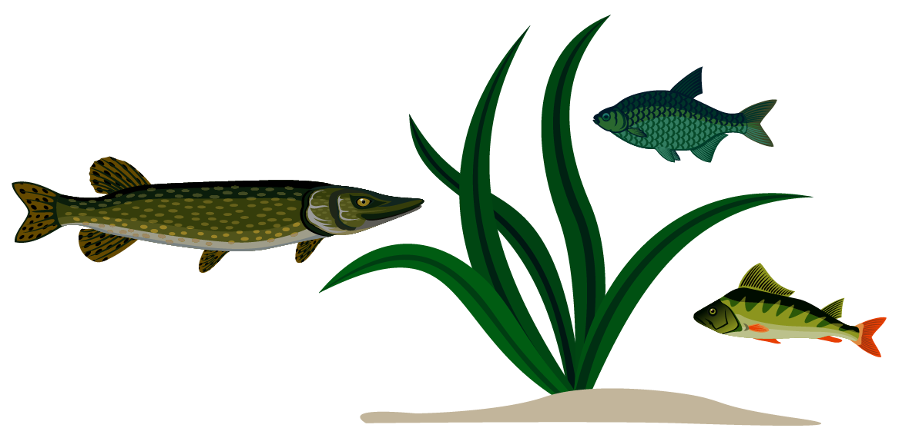
Recycled Water Helps Our Environment
Relieves pressure on Florida’s water resources and ecosystems
More water remains in our rivers and springs for the fish, plants and wildlife that rely upon them such as fish, birds and the endangered manatee
Notes:
Recycled Water Helps Our Environment
Relieves pressure on Florida’s water resources and ecosystems
More water remains in our rivers and springs for the fish, plants and wildlife that rely upon them such as fish, birds and the endangered manatee

Slide 9
Recycled Water Around the World and Beyond
Recycled water projects have been implemented from coast to coast in the United States, around the globe and even in space.
Notes:
The concept of using this type of recycled water is not new.
A variety of recycled water projects have been implemented from coast to coast in the United States, around the globe and even in space.
You can visit our OneWaterFlorida.org and view an interactive map highlighting project across the United States and the world.

Slide 10
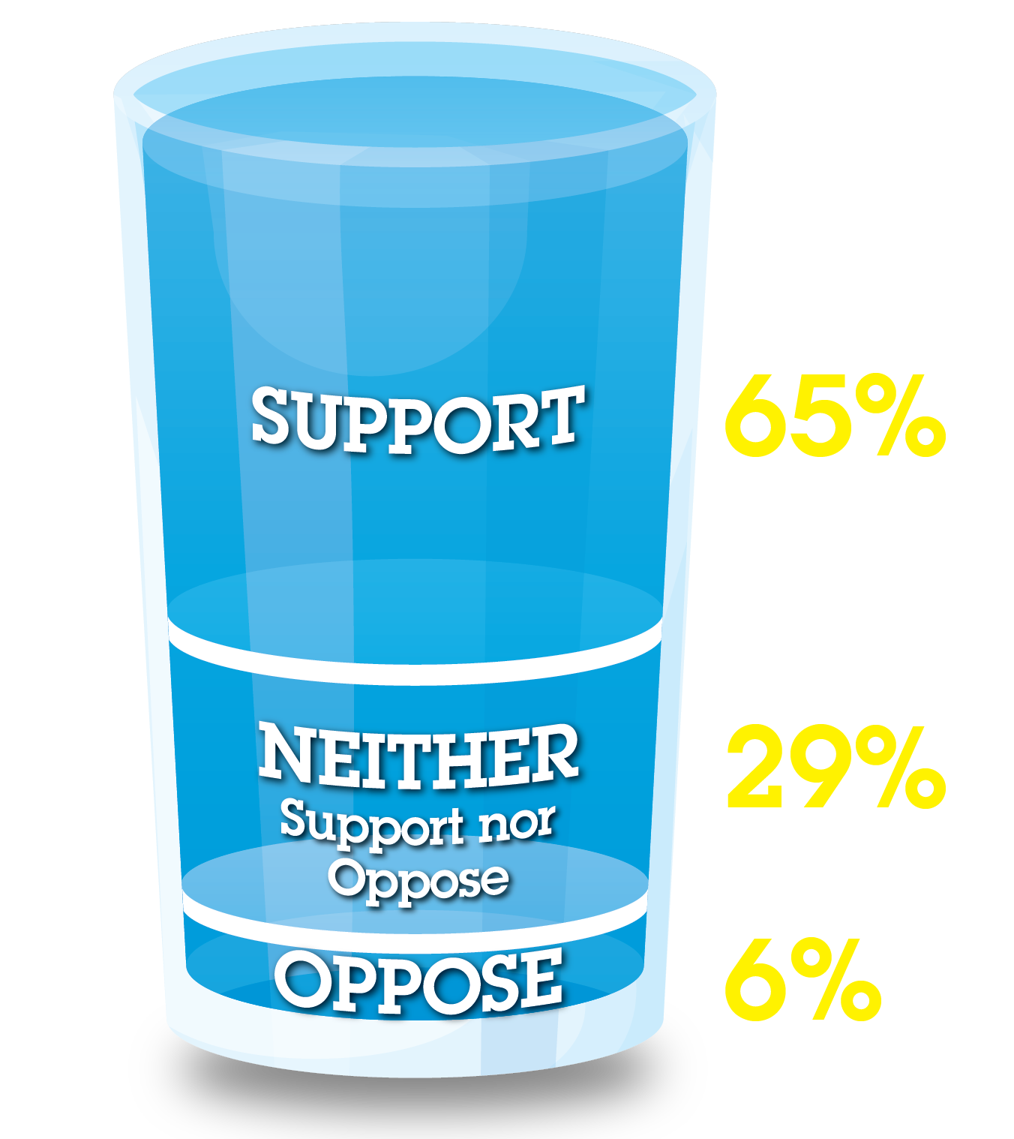
Public Sentiment
A statewide survey funded by DEP found the majority of respondents supported indirect and direct potable reuse for all household purposes after they were educated on this type of recycled water.
Notes:
As Florida water needs grow so does public support.
A statewide survey funded by DEP found the majority of respondents supported indirect and direct potable reuse for all household purposes after they were educated on this type of recycled water.

Slide 11
Next Steps for Recycled Water in Florida
Clean Waterways Act in 2020 gave DEP the authority it needs to create and update regulations
DEP initiated the public process to update its regulations based on the Florida Potable Reuse Commission’s recommendations
Regulations will address contaminants of emerging concern, and federal and state drinking water quality standards
DEP’s regulations will ensure all recycled water is safe
Notes:
What are the next steps for recycled water in Florida?
Clean Waterways Act in 2020 gave DEP the authority it needs to create and update regulations.
DEP initiated the public process to update its regulations based on the Florida Potable Reuse Commission’s recommendations.
Regulations will address contaminants of emerging concern, and federal and state drinking water quality standards.
DEP’s regulations will ensure all recycled water is safe.
Many cities and counties in Florida are already developing potable reuse studies and pilot projects.

Slide 12
OneWaterFlorida.org
Recycled water facts
Experts working with recycled water
Projects around the world
Additional resources
Notes:
We encourage you to visit OneWaterFlorida.org to learn much more about potable reuse
The site has fact sheets and frequently asked questions
You can learn more about experts working with recycled water
As I mentioned, you can view an interactive map about the projects around the world.
Plus, additional resources, such as research, presentations, videos and online publications.

Slide 13
Questions?
Notes:
Questions:

