Slide 1
Conservation as a Way of life In california PROVISIONS FOR REUSE WateReuse California Regulatory Forum September 21, 2023

Slide 2
Overview
Conservation as a Way of Life in California
Water Use Objective and Reuse
Residential Indoor Standards
Recycled Water Irrigation Standards
Exemption from Ban on Non-Functional Turf
Variances
High TDS
Impacts on Wastewater
Recycled Water Irrigated Area
Bonus Incentive for Potable Reuse
Concerns to Address

Slide 3
“Conservation as a way of life in California”
Establishes water efficiency standards (Water Use Objective or WUO) and best management practices for urban water retail suppliers
Indoor standards established by legislature in 2022
State Water Resources Control Board to adopt other efficiency standards
State Board initiated formal rule-making to adopt standards in August 2023
Workshop October 4, 2023
Comment letters due October 17, 2023
Adoption expected Spring/Summer 2024
Annual reporting begins January 2024
Water Use Objective annual calculation begins January 2025
Compliance begins 2027

Slide 4
Water use objective and reuse
Reduced residential indoor flows may have impacts on wastewater and reuse

Slide 5
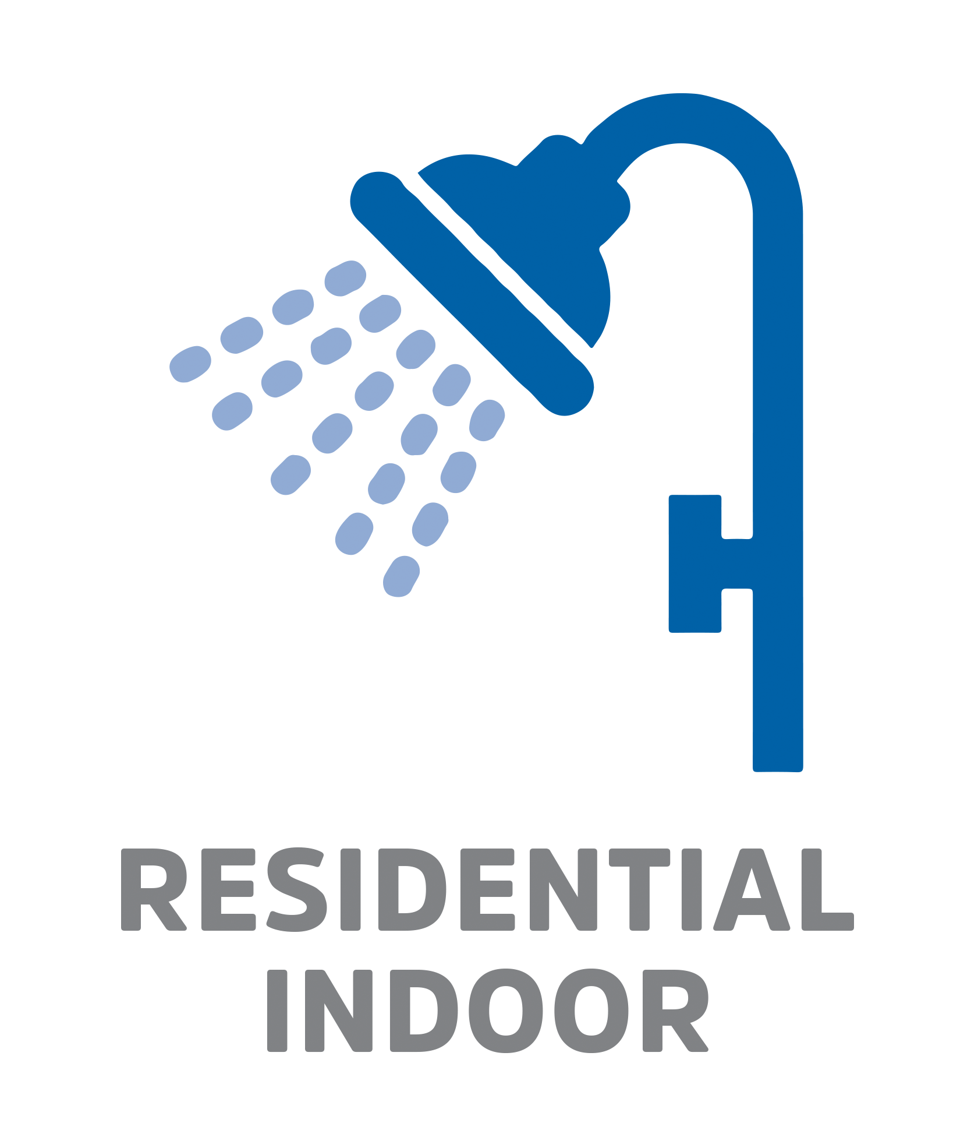
Residential indoor standards
Established by SB 1157 (2022)
DWR to conduct studies to quantify impacts on water, wastewater and recycled water systems by October 2028
Governor’s signing message encourages State Water Board to adopt variances to reflect local investments in recycled water and infrastructure

Slide 6
Recycled water irrigation standards
 | Residential Standards | CII Standards
Through June 2028 | 0.8 | Equivalent to actual reported deliveries
July 2028- June 2030 | 0.8 | 0.8
July 2030 – June 2035 | 0.63 | 0.63
July 2035 on | 0.55 | 0.45
Special Landscape Area (SLA) Irrigated with Recycled Water | 1.0 Reference to MWELO | 1.0 Reference to MWELO Variance for high TDS
Variance for High TDS |  | 
New Development (post-2018) | 0.55 | 0.45 Reference to MWELO
Precipitation Adjustment (Reduction) | Up to 25% | Up to 25%
Proposed standards are factors to reduce amount of water relative to evapotranspiration (ET). Well-irrigated cool-season turfgrass ranges from 0.8. to 1.0.

Slide 7
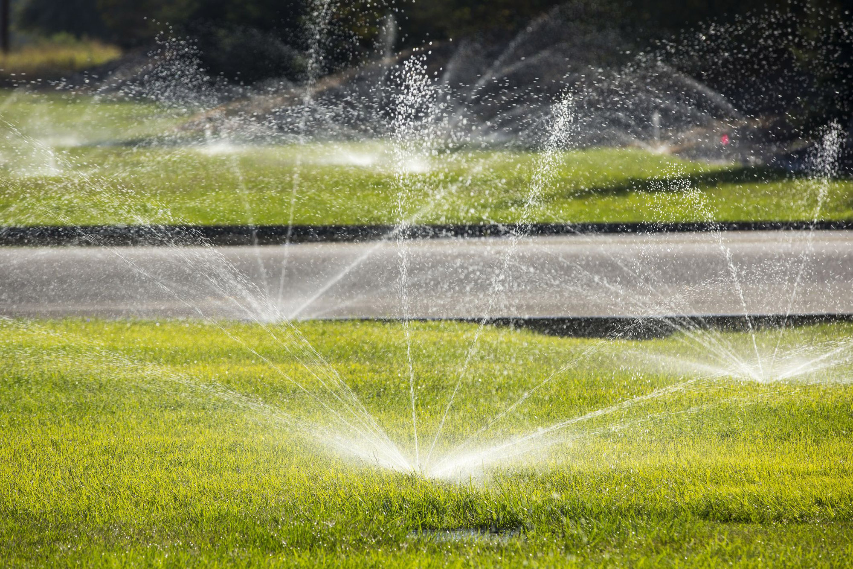
Ban on CII non-functional turf
Suppliers shall ban irrigation of non-functional turf with potable water on all CII landscapes by July 1, 2025
Sites irrigated with recycled water exempt from the ban

Slide 8
Variances

Slide 9
Variance for high tds – method 1
If sum of budget use is 5% or more of water use objective
Special Landscape Variance (calculated annually)
Recycled water with TDS concentrations between 900 and 1,600 milligrams per liter (mg/L) or higher
(Concentration of recycled water – 900) x 0.000371
(1,600 – 900 mg/L) x 0.000371 = 0.26 TDS Variance Factor
1,600+ mg/L = 0.26 maximum additional factor added to 1.0 SLA factor
Total Max. Variance = 1.0 standard SLA factor + 0.26 TDS Variance
Maximum landscape factor = 1.26

Slide 10
Variance for high tds – method 2
If sum of budget use is 1% or more of water use objective
Can use detailed plant based leaching requirements.
Complex annual calculation based on:
Salinity, capped at 1600 mg/L
Specific plant factors, at least 30% coverage for lowest water using plant
Plant’s salinity threshold
Efficiency of irrigation system, sprinklers (75%) or drip (81%)

Slide 11
Impacts to wastewater
Suppliers may request temporary provision to respond to negative impacts to wastewater collection, treatment and reuse systems
Demonstrate need to adhere to the indoor standard to meet the overall water use objective; and
Demonstrate that it is causing challenges
Submit a request for approval by October 1 each year
Demonstrate how it protects beneficial uses
Quantify and substantiate each request
Demonstrate that it would not jeopardize permit compliance

Slide 12
special landscape area Measurements
Areas irrigated with recycled water considered SLAs
Requires water agencies to submit documentation of SLA residential and CII dedicated meters area measurements by October 1 each year for approval by State Board staff:
Demonstrate how it protects beneficial uses
Quantify and substantiate each request
Demonstrate that it would not jeopardize permit compliance
Describe efforts to prioritize the water use for existing trees

Slide 13
Bonus incentive for potable reuse

Slide 14
potable reuse bonus incentive
Recognizes importance of potable reuse (direct and indirect) as a critical component of regional self-reliance and water resiliency
Balances State policies to encourage water reuse as a supply with water conservation policies
Follows DWR recommended approach, proposed by WateReuse with NGO support
Current methodology is for indirect potable reuse
Request that methodology for direct potable reuse be developed following adoption of DPR regulations

Slide 15
What is the bonus incentive?
Provides a bonus for potable reuse that is added to the Water Use Objective
Based on how much potable reuse is within the potable deliveries associated with the Water Use Objective
Capped at 10% or 15% of the Water Use Objective
Existing Facilities:
Up to 15% of sum of applicable budgets used to calculate Water Use Objective
Certified environmental documents before January 1, 2019
Producing and delivering potable reuse water on or before January 1, 2022
Uses microfiltration and reverse osmosis technologies
New Facilities:
Up to 10% of sum of applicable budgets used to calculate Water Use Objective

Slide 16
Bonus incentive calculation – what applies?
Includes:
All residential: Indoor and Outdoor
All potable dedicated irrigation/landscape
Excludes:
All CII use (other than potable dedicated landscape)
All recycled water
Water loss

Slide 17
WUO potable applicable metered deliveries
Customer Class and Type | Annual Use AF | Part of WUO? | Potable Water? | Potable WUO Metered Deliveries? | Total WUO Potable Metered Deliveries AF
Residential | 8,000 | Yes | Yes | Yes | 8,000
Potable CII Dedicated Irrigation | 2,000 | Yes | Yes | Yes | 2,000
Recycled Dedicated Irrigation | 1,000 | Yes | No | No | -
Commercial, Industrial and Institutional (CII) – Indoor Use | 1,500 | No | Yes | No | -
Water Loss | 250 | Yes | Yes | No | -
Variance Potable | Included | Yes | Yes | Included | -
Variance Recycled | 250 | Yes | No | No | -
Total | 13,000 |  |  |  | 10,000

Slide 18
Determine volume of potable reuse
Steps: Groundwater Basins or Reservoir Augmentation
Total volume of potable reuse recharged into basin or used for reservoir augmentation
Annual average based on preceding 5 years
Adjust for losses
Calculate total volume of groundwater extracted or total volume of water produced by the reservoir
Determine volume of water used by each water retailer and percentage of total
Proportionately allocate volume of potable reuse after losses to each producer
Example
Total annual average volume of reuse = 30,000 AF
Losses = 5% Loss Factor = 95%
Total basin or reservoir production = 150,000 AF
Retailer A use = 50,000 AF
30,000 AF volume potable reuse
30,000 x 0.95 = 28,500 AF reuse after loss
Total volume produced/extracted = 150,000 AF
Retailer A = 50,000 AF use = 50,000/150,000 = 33%
Retailer A Potable Reuse = 28,500 AF x 0.33 = 9,500 AF

Slide 19
Calculate Bonus incentive
Steps:
Total volume of applicable WUO potable metered deliveries
Residential
Potable CII DIMs
Adjust for losses
Divide applicable by total potable deliveries to determine percentage
Multiply percentage by total potable reuse to calculate how much of the potable resuse goes to WUO
Capped at 15% or 10% of WUO
Example
Retailer A total potable reuse = 9,500 AF
Total residential and potable CII DIMs = 40,000 AF
Total potable use = 50,000 AF
Water Use Objective = 35,000 AF
Facility on-line before 2020 = eligible for 15% bonus
40,000 AF of applicable WUO potable deliveries
40,000/50,000 AF = 80 % of total potable use
Retailer A Bonus = 9500 x 0.8 = 7,600 AF
15% Cap = Water Use Objective x 0.15 = 35,000 x 0.15 = 5,250 AF Bonus
Final WUO = 35,000 + 5,250 Bonus Final WUO = 40,250 AF

Slide 20
Outstanding
concerns

Slide 21
concerns to be addressed
1157 Indoor Standards: Variance or provision for wastewater impacts should not be temporary
Landscape Efficiency Factor (LEF) of 1.0 for recycled water should be clearly defined in the regulation as 1.0, and not through reference to MWELO
Landscape area measurements for SLAs irrigated with recycled water should not require annual variance process.
Methodology to calculate the bonus incentive for DPR needs to be developed once the DPR regulations are adopted

